Slide 1


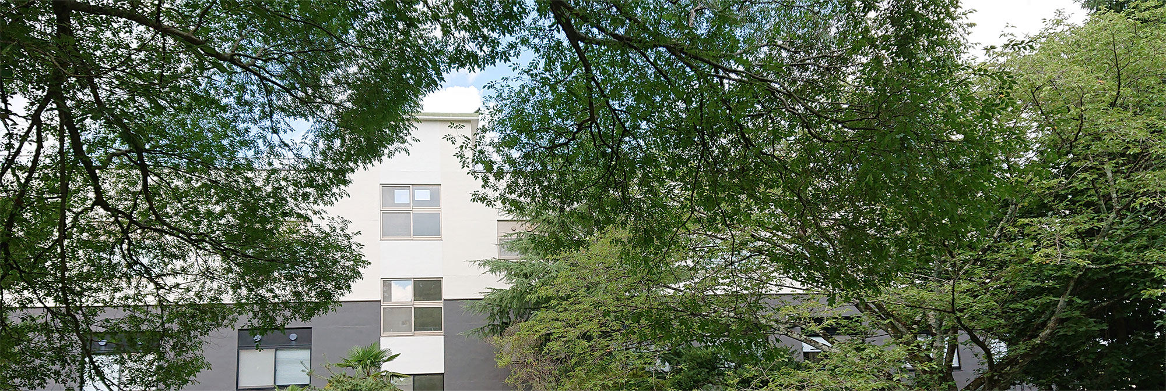
Next-Generation Experiments on Kaonic Nuclei at J-PARC
Yuto Kimura
RARiS, Tohoku University RIKEN Nishina Center for Accelerator-Based Science
E-Mail: y_kimura@raris.tohoku.ac.jp
For the J-PARC E80 collaboration
RARiS研究会2025 「実験・有効理論・格子シミュレーションで探るハドロンダイナミクス」

Slide 2
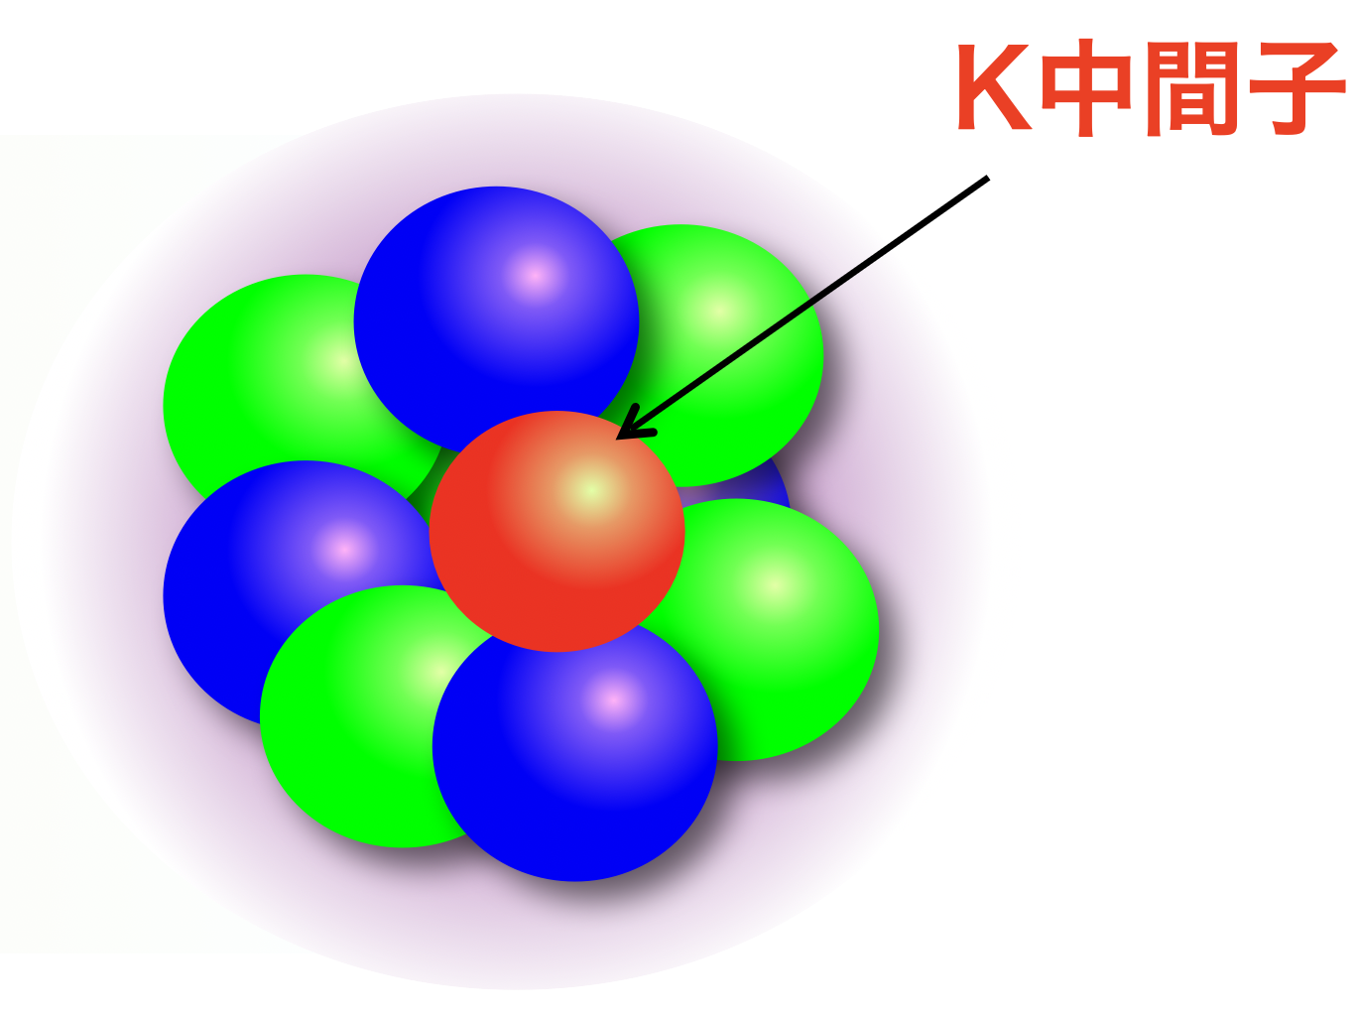
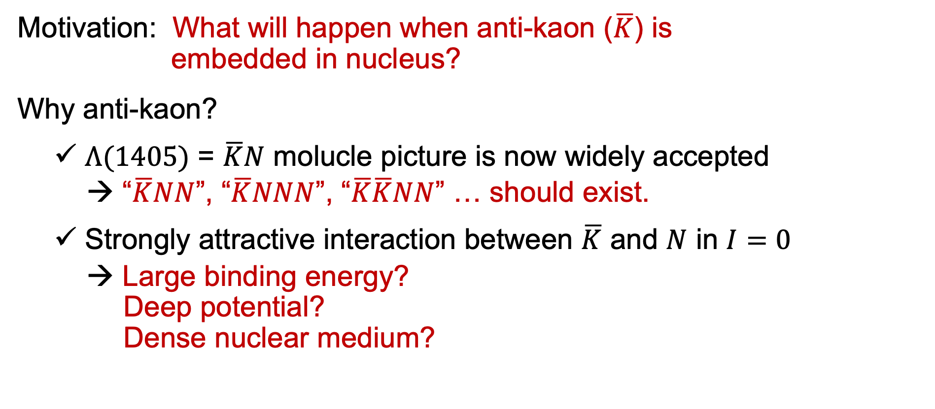
Kaonic Nuclei
anti-kaon
Motivation: What will happen when anti-kaon ($\overline{K}$) is embedded in nucleus?
Why anti-kaon?
$Λ(1405)$ = $\overline{K}N$ molucle picture is now widely accepted
→ “$\overline{K}NN$”, “$\overline{K}NNN$”, “$\overline{K}\overline{K}NN$” … should exist.
Strongly attractive interaction between $\overline{K}$ and $N$ in $I=0$
→ Large binding energy? Deep potential? Dense nuclear medium?
Experimentalists began with simpler systems.
Theory calculations also suggest that these bound states exist.

Slide 3
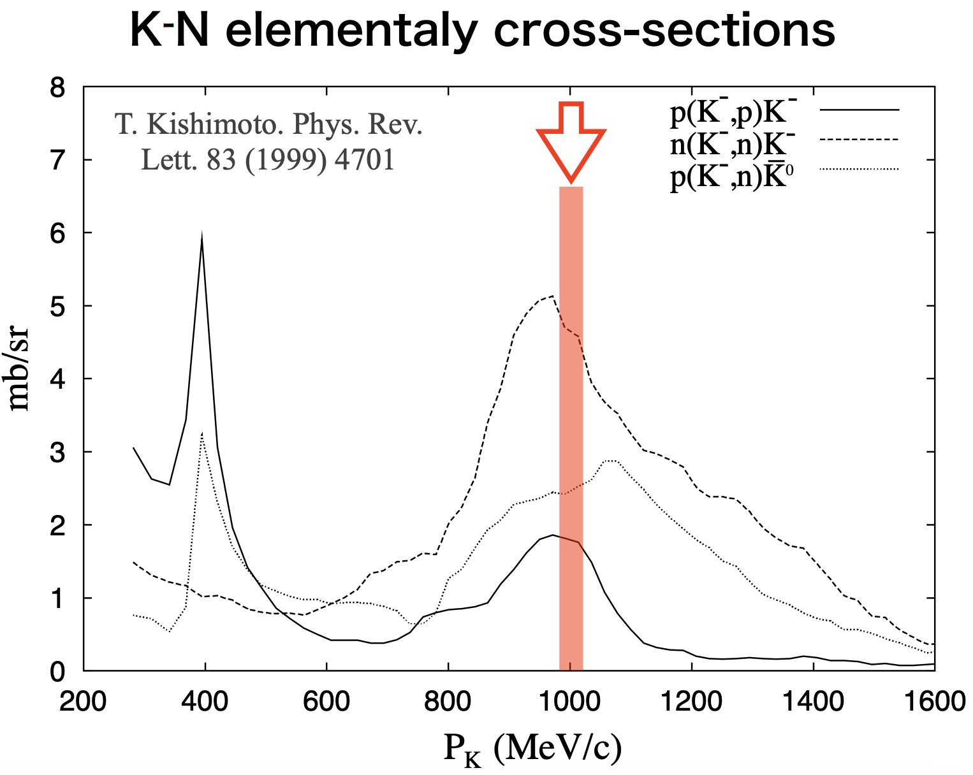
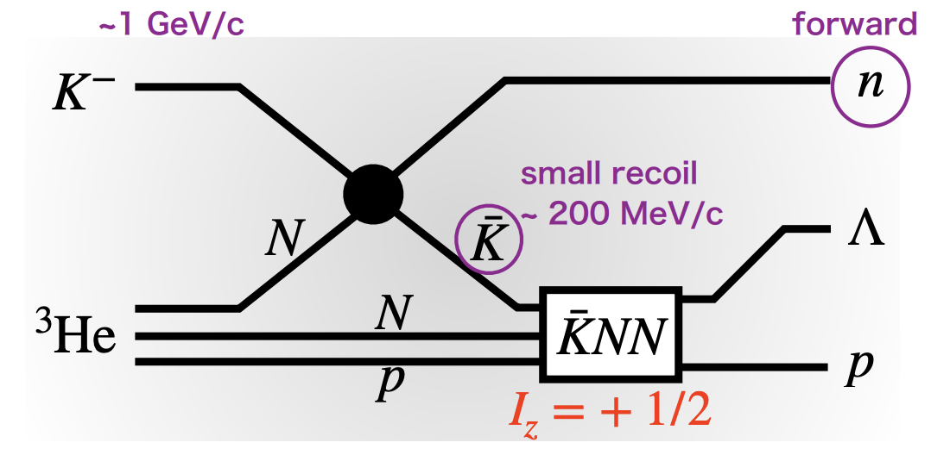
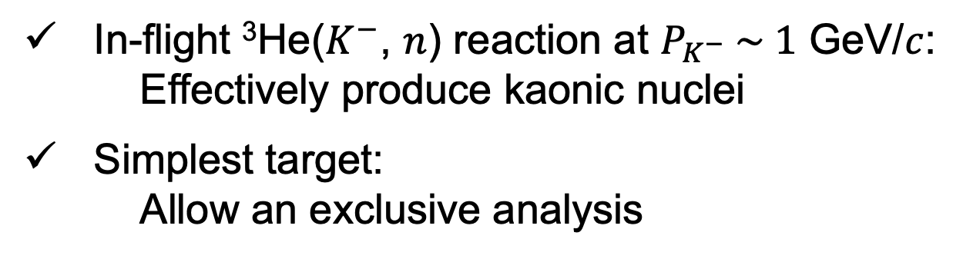
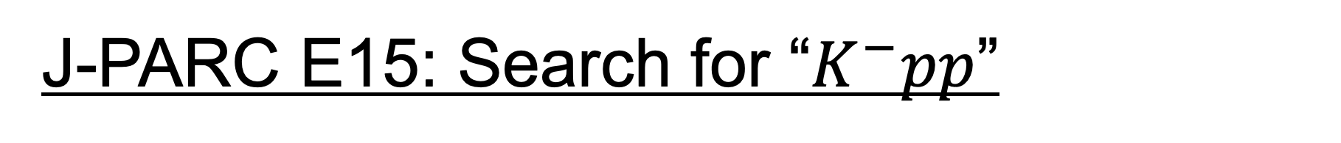
J-PARC E15: Search for “$K^{−}pp$”
In-flight ³He($K^{−}$, $n$) reaction at $P_{K^{−}} \sim 1$ GeV/$c$: Effectively produce kaonic nuclei
Simplest target: Allow an exclusive analysis

Slide 4
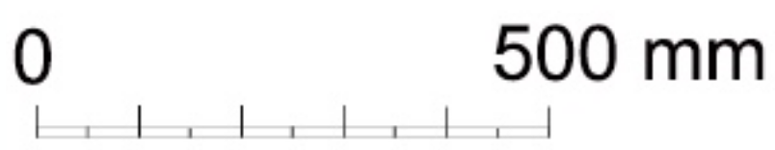
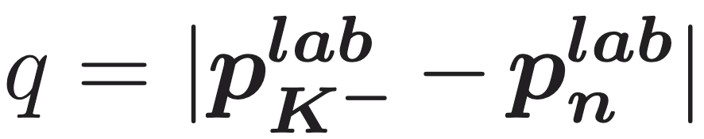
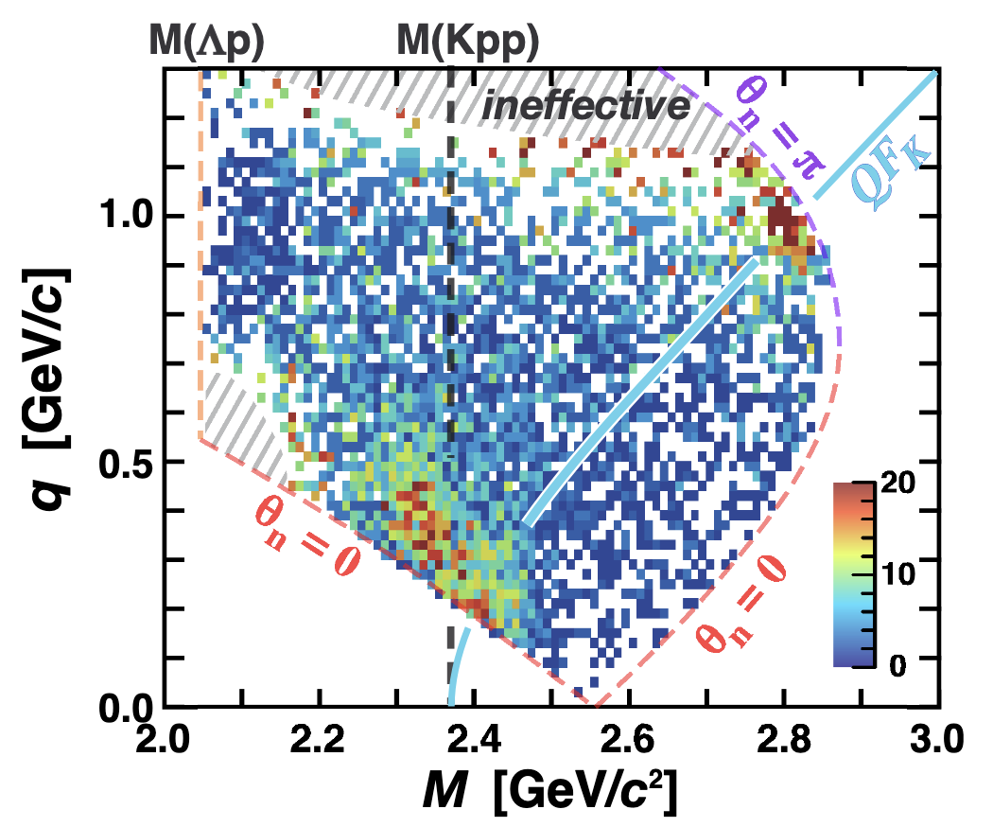
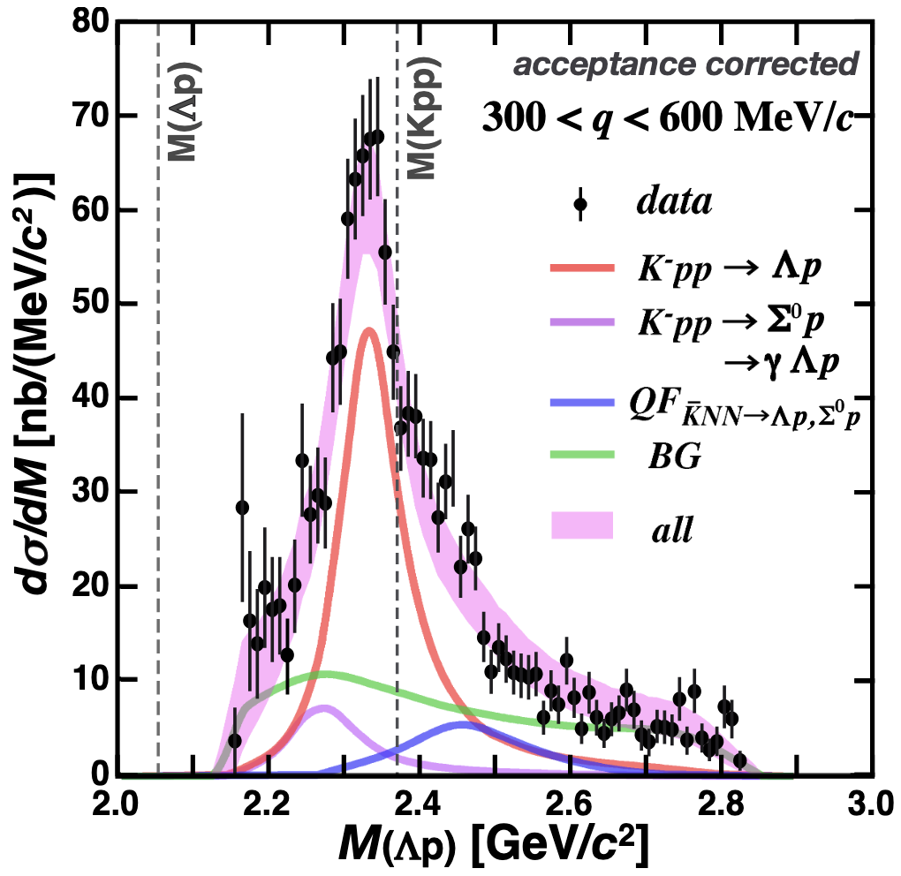
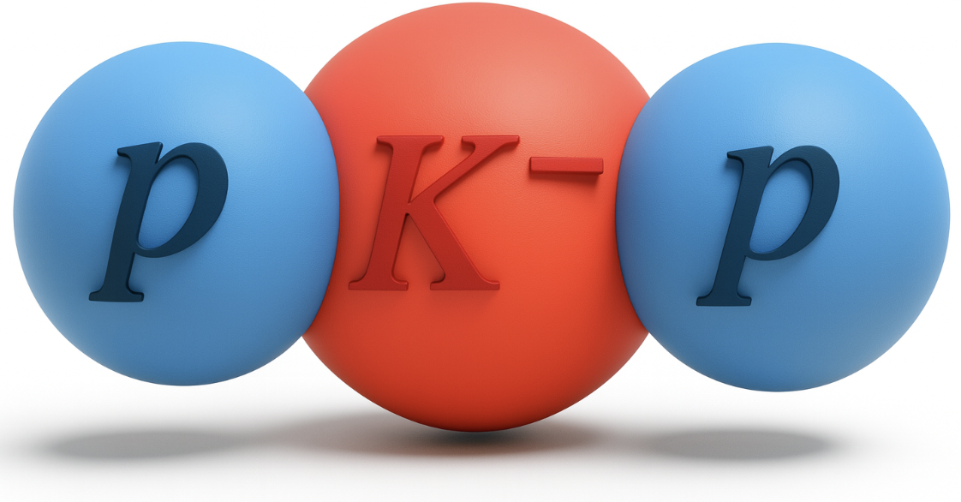


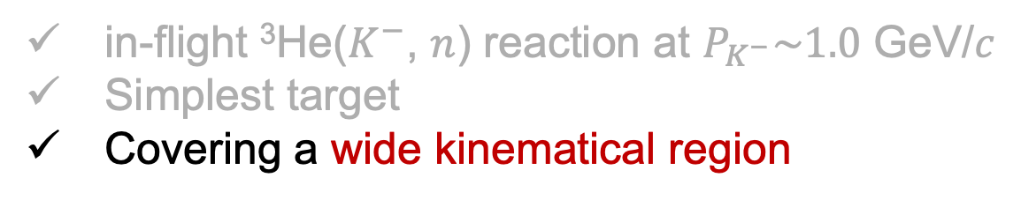
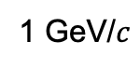
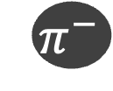




J-PARC E15: Search for “$K^{−}pp$”
$$π^{−}$$
$$p$$
in-flight ³He($K^{−}$, $n$) reaction at $P_{K^{−}}\sim 1.0$ GeV/$c$
Simplest target
Covering a wide kinematical region
1 GeV/$c$
$$Λ$$
$$K^{−}$$
$$n$$
$$K^{−}pp$$
missing
³He-target
CDC (Tracker)
CDH (TOF counter)
$$p$$
Solenoid
Bound
Unbound
Large B.E ~40 MeV
Decay width ~ 100 MeV
They could clearly separate signal from background with data of wide kinematical region.

Slide 5
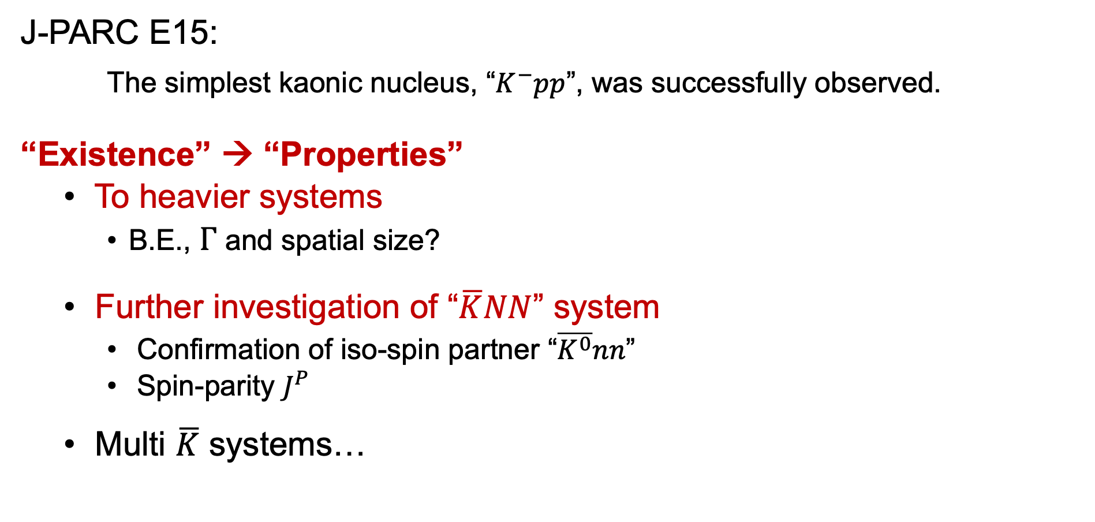
Next Projects
J-PARC E15:
The simplest kaonic nucleus, “$K^{−}pp$”, was successfully observed.
“Existence” → “Properties”
To heavier systems
B.E., $Γ$ and spatial size?
Further investigation of “$\overline{K}NN$” system
Confirmation of iso-spin partner “$\overline{K^{0}}nn$”
Spin-parity $J^{P}$
Multi $\overline{K}$ systems…
This talk
J-PARC E80
J-PARC E89

Slide 6
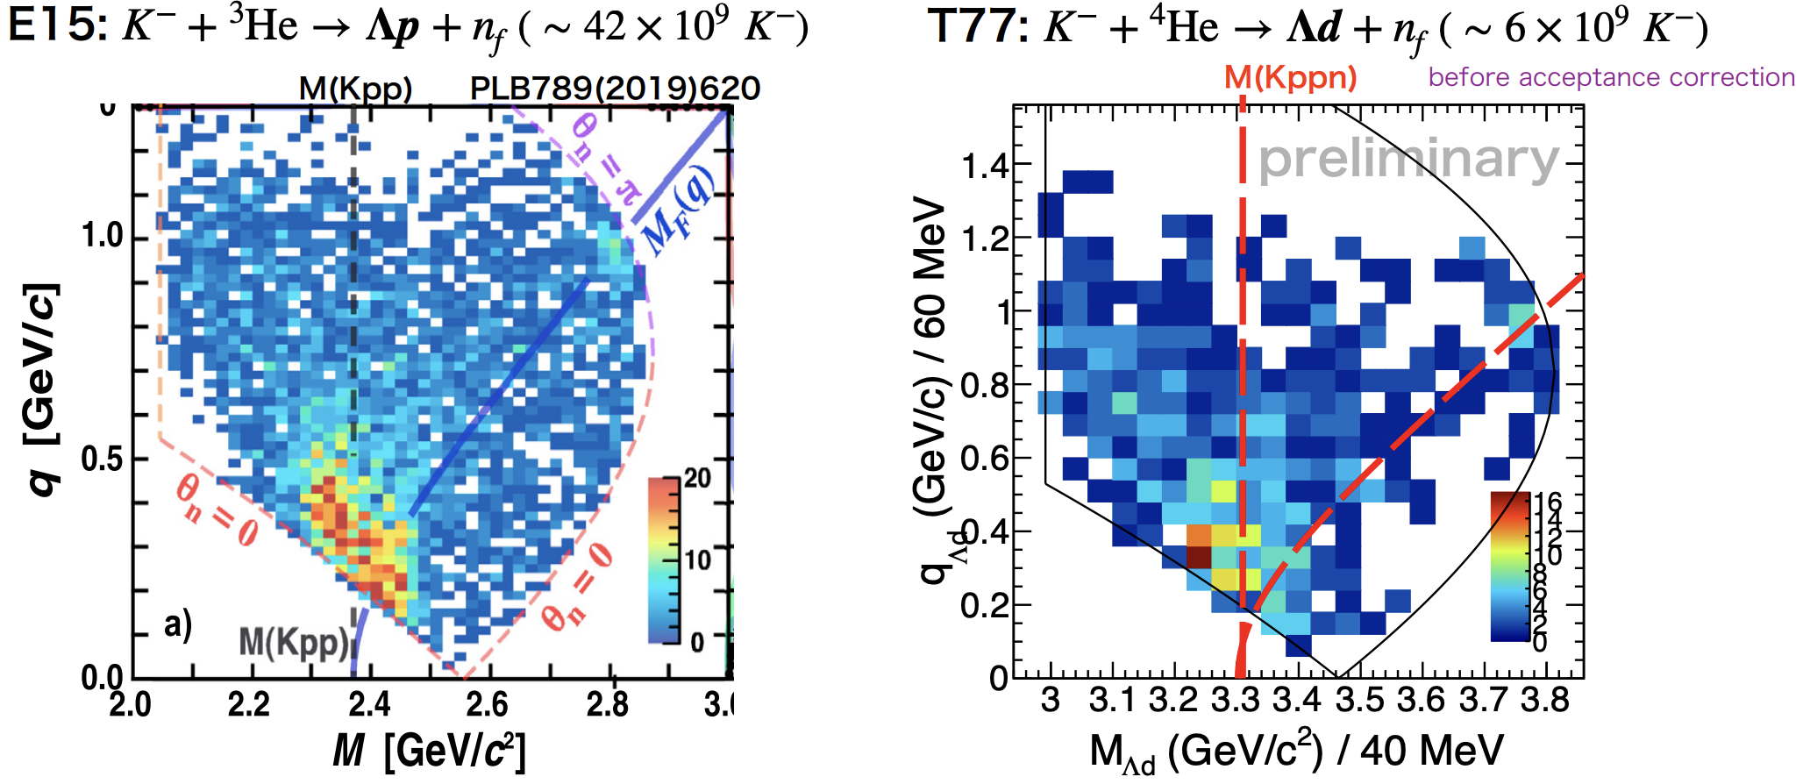
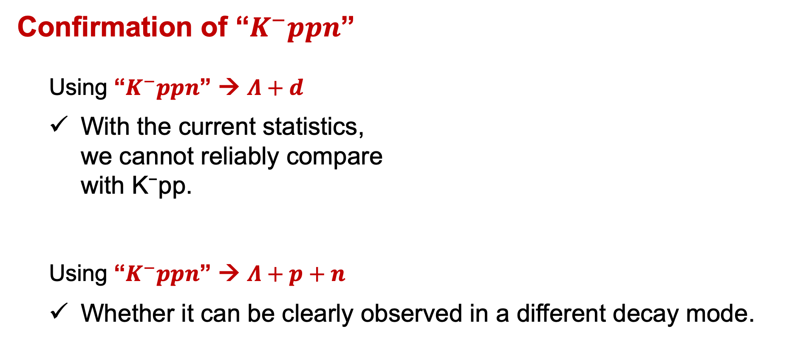
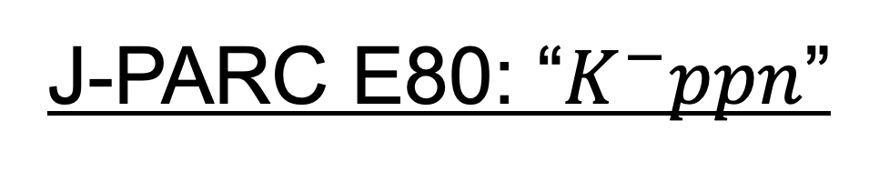
J-PARC E80: “$K^{−}ppn$”
Confirmation of “$K^{−}ppn$”
Using “$K^{−}ppn$” → $Λ+d$
With the current statistics, we cannot reliably compare with K⁻pp.
Using “$K^{−}ppn$” → $Λ+p+n$
Whether it can be clearly observed in a different decay mode.
Limited statistic…

Slide 7
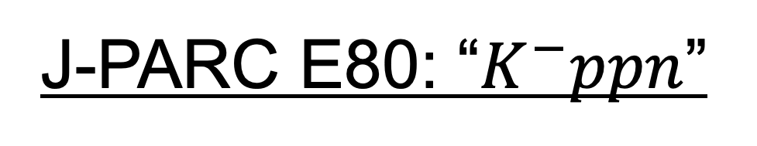
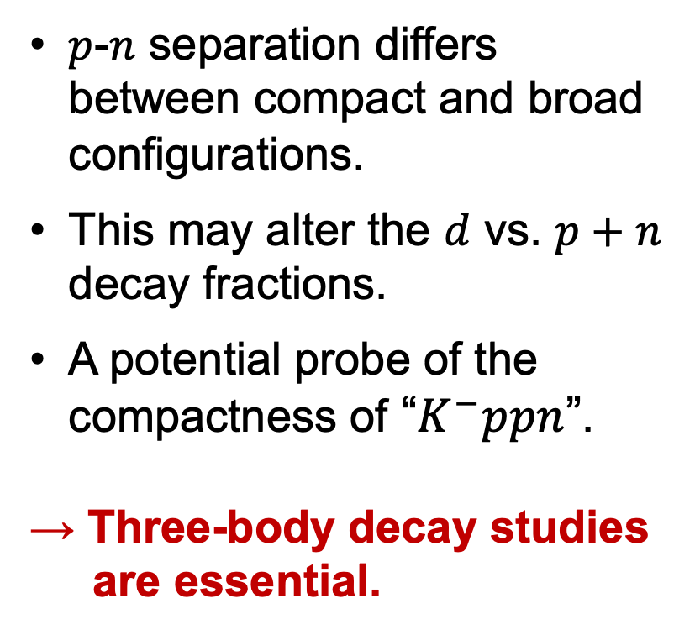
J-PARC E80: “$K^{−}ppn$”
Spatial size from comparison $Λd$ with $Λpn$ decay mode
Compact case
$p$-$n$ separation differs between compact and broad configurations.
This may alter the $d$ vs. $p+n$ decay fractions.
A potential probe of the compactness of “$K^{−}ppn$”.
→ Three-body decay studies are essential.
p
Λ
p
p
Λ
K–
n
n
d
K-nucl
Two nucleus absorption
Dominant decay mode(?)
p
p
p
Λ
p
K–
Λ
n
n
n
Broad case

Slide 8
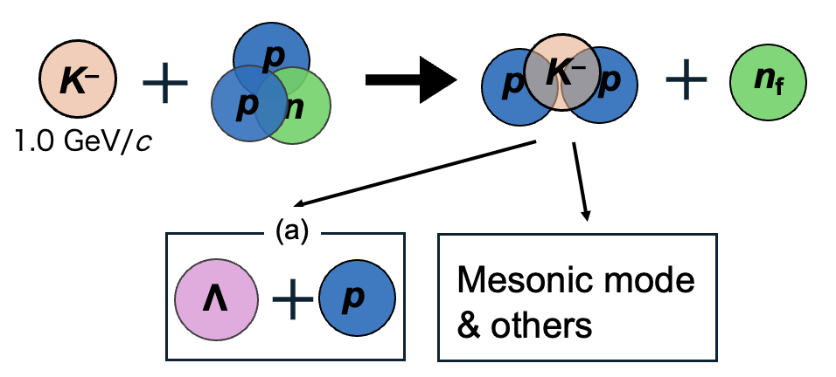
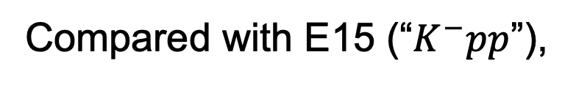
J-PARC E80: “$K^{−}ppn$”
c.f.) Case of E15
What and how we will measure:
n
p
p
p
K–
K–
n_{f}
p
n
Missing Mass or forward TOF counter
n
1.0 GeV/c
Mesonic mode & others
Λ
d
Λ
n
p
Measured by Cylindrical Detector System (CDS)
Compared with E15 (“$K^{−}pp$”),
More decay particles
Neutron must be detected…

Slide 9
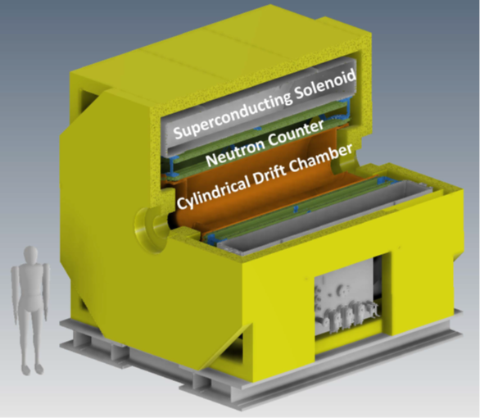
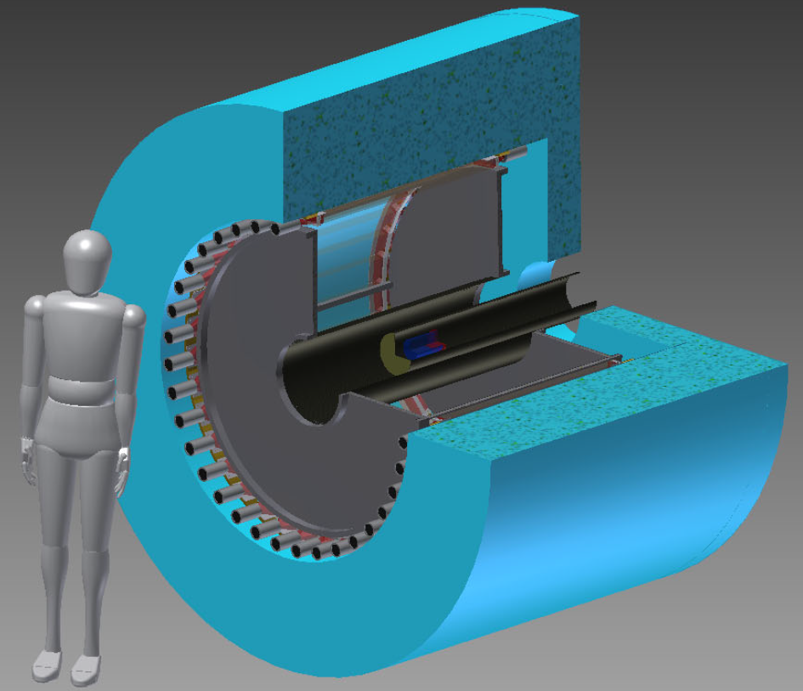
New Cylindrical Detector System
New CDS
E15-CDS
1.48 m
1.97 m
Solid Angle: x1.6 (59% → 93%)
Neutron Detection Efficiency: x4 (3% → 12%) + forward TOF counter
+ proton polarimeter
Beam
3.28 m
3.85 m

Slide 10
New Cylindrical Detector System
3.85 m
Cylindrical Neutron Counter
Yoke
Neutron detection
PID for charged particles
Resolution
σ_{time} ~ 80 ps (same as E15)
σ_{mom_n} < 7% (momentum dep.)
Super-conducting Solenoid
π–
p
1.0 GeV/c
^{3/4}He Target
Λ
n_{f}
K–
Cylindrical Drift Chamber
Momentum calculation from curvature of tracks
Momentum Resolution is equal to the same as E15-CDC.
CapTOF
p
n
Vertex Fiber Tracker
Polarimeter Tracker
To reinforce the vertex point resolution, especially Z-pos resolution.
The overall resolution is comparable to, or better than, that of the E15 CDS.

Slide 11
Improvement of Detector Acceptance
Λd in CDS
M(Kppn)
M(Kppn)
Overall, the efficiency increases by ~2x, and the key sub-threshold region maintains a high acceptance in wide $q$ region.

Slide 12
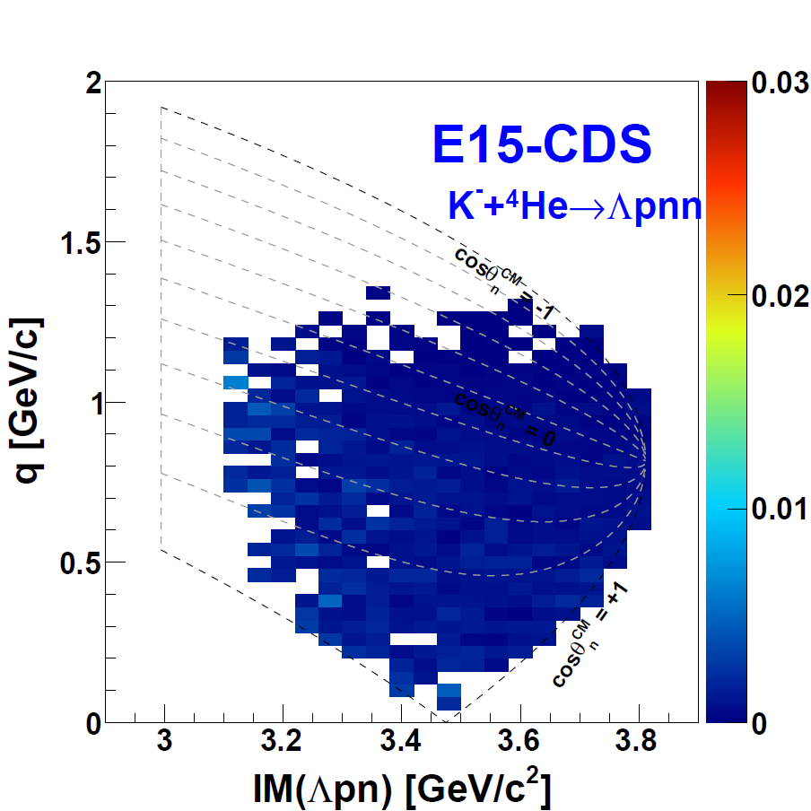
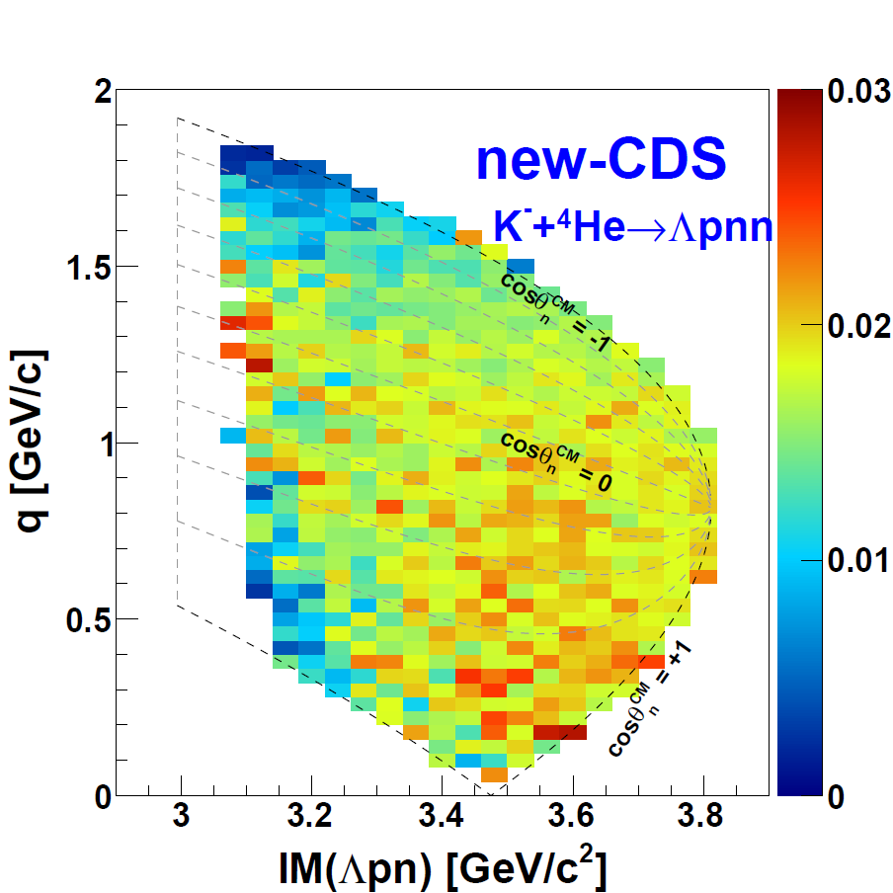
Improvement of Detector Acceptance
Λpn in CDS
For three-body decays, the acceptance will be dramatically improved compared to the E15-CDS, more than a factor of five.

Slide 13
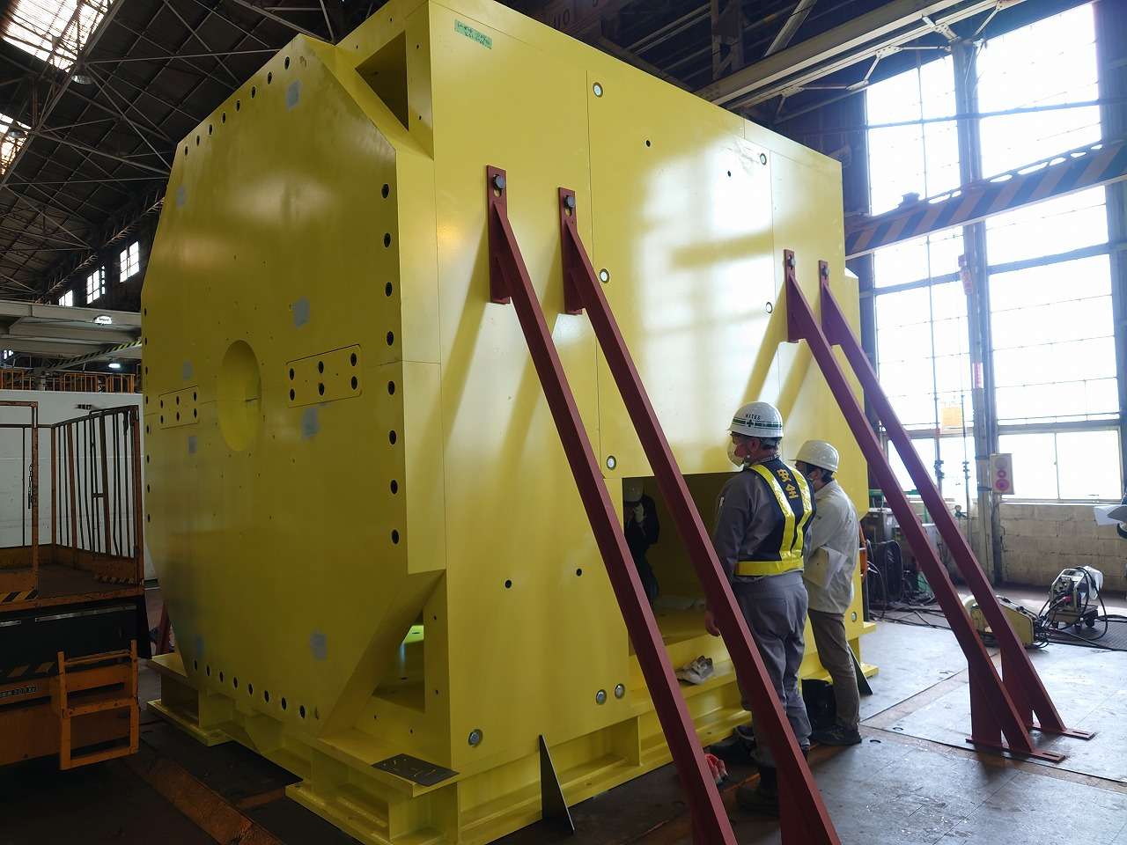
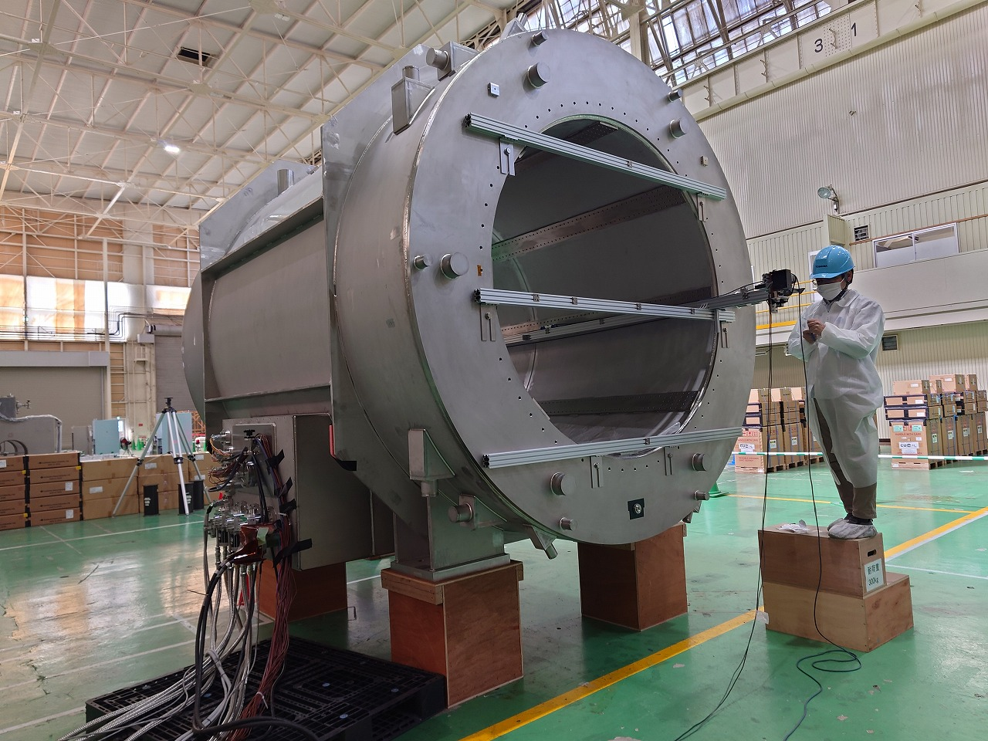
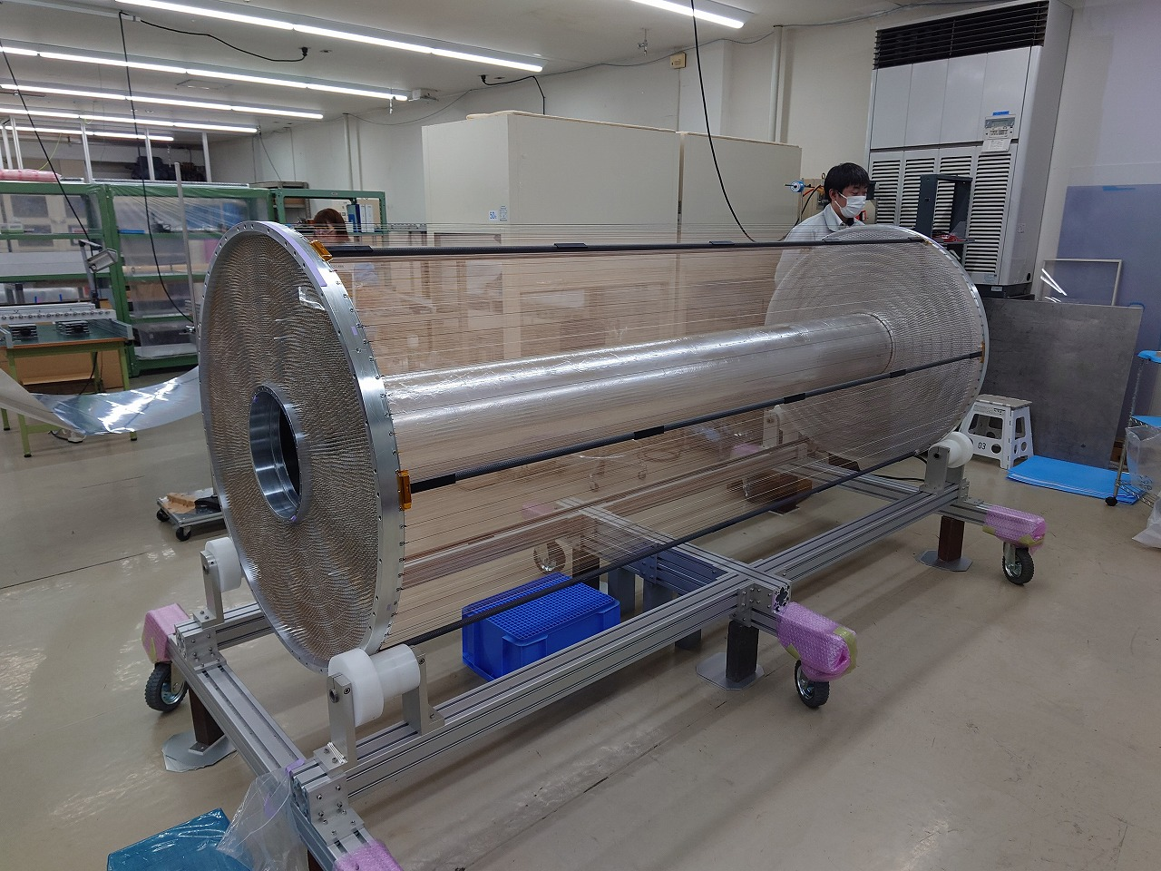
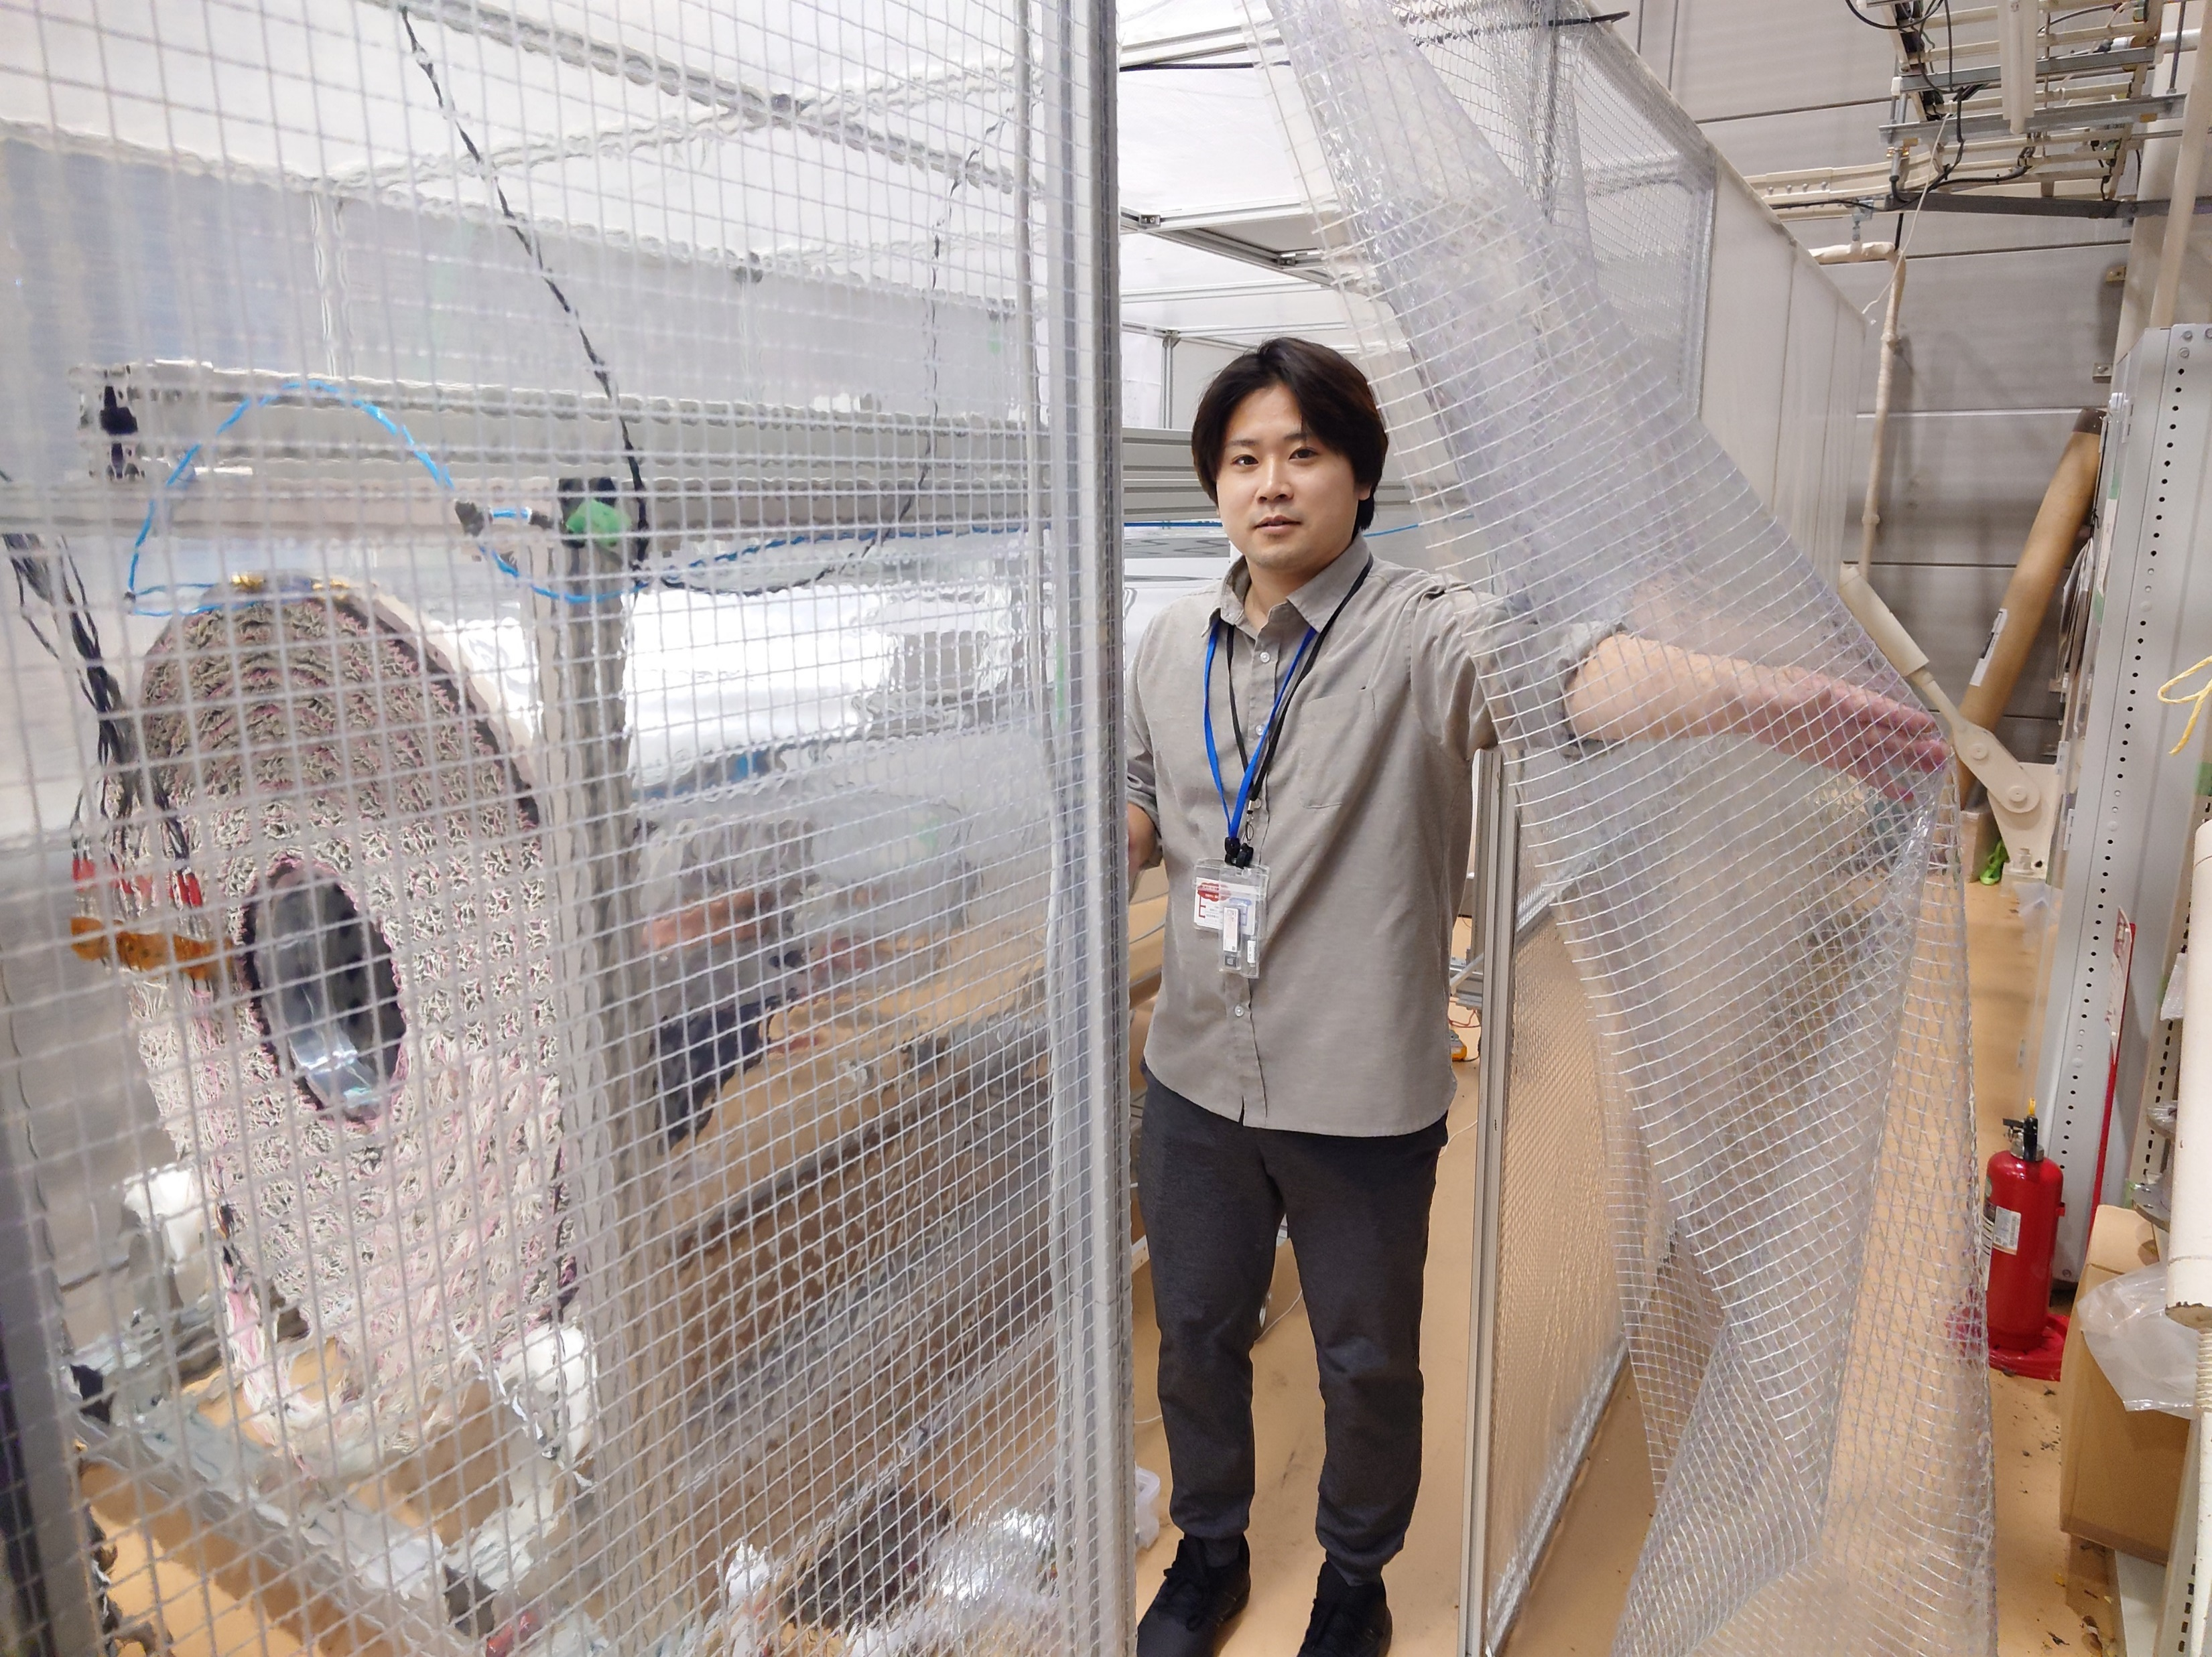
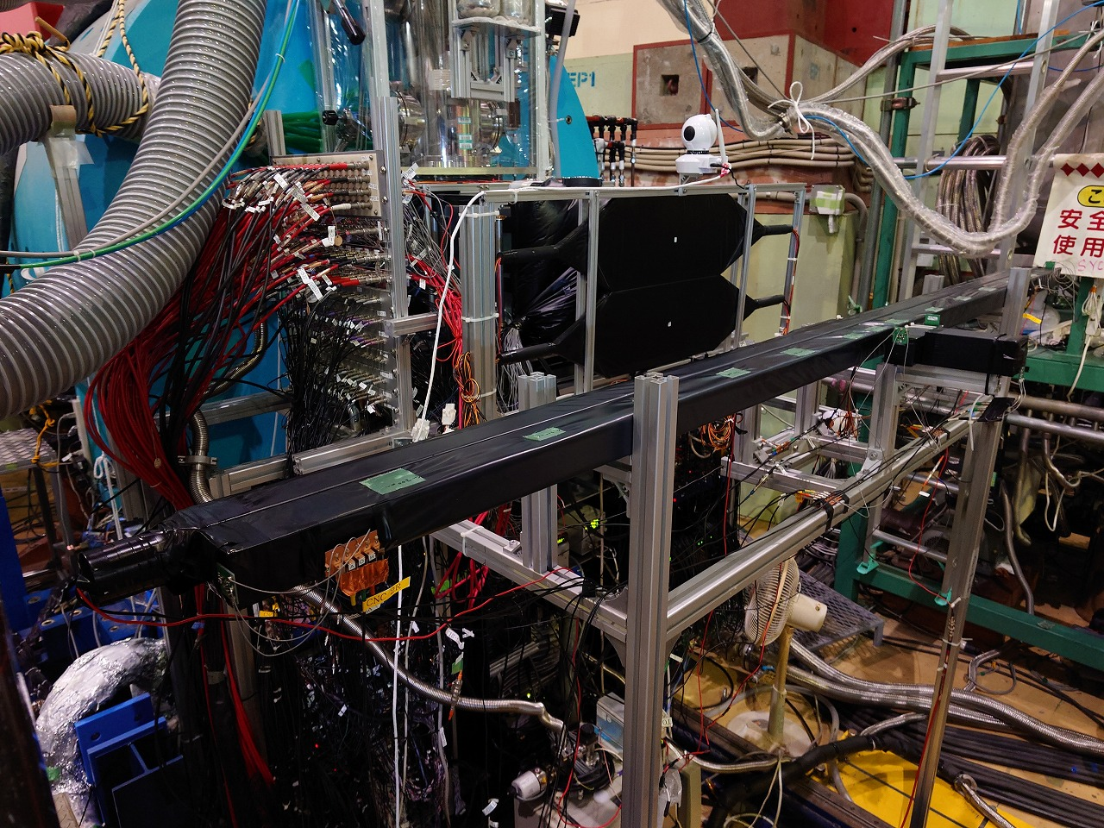
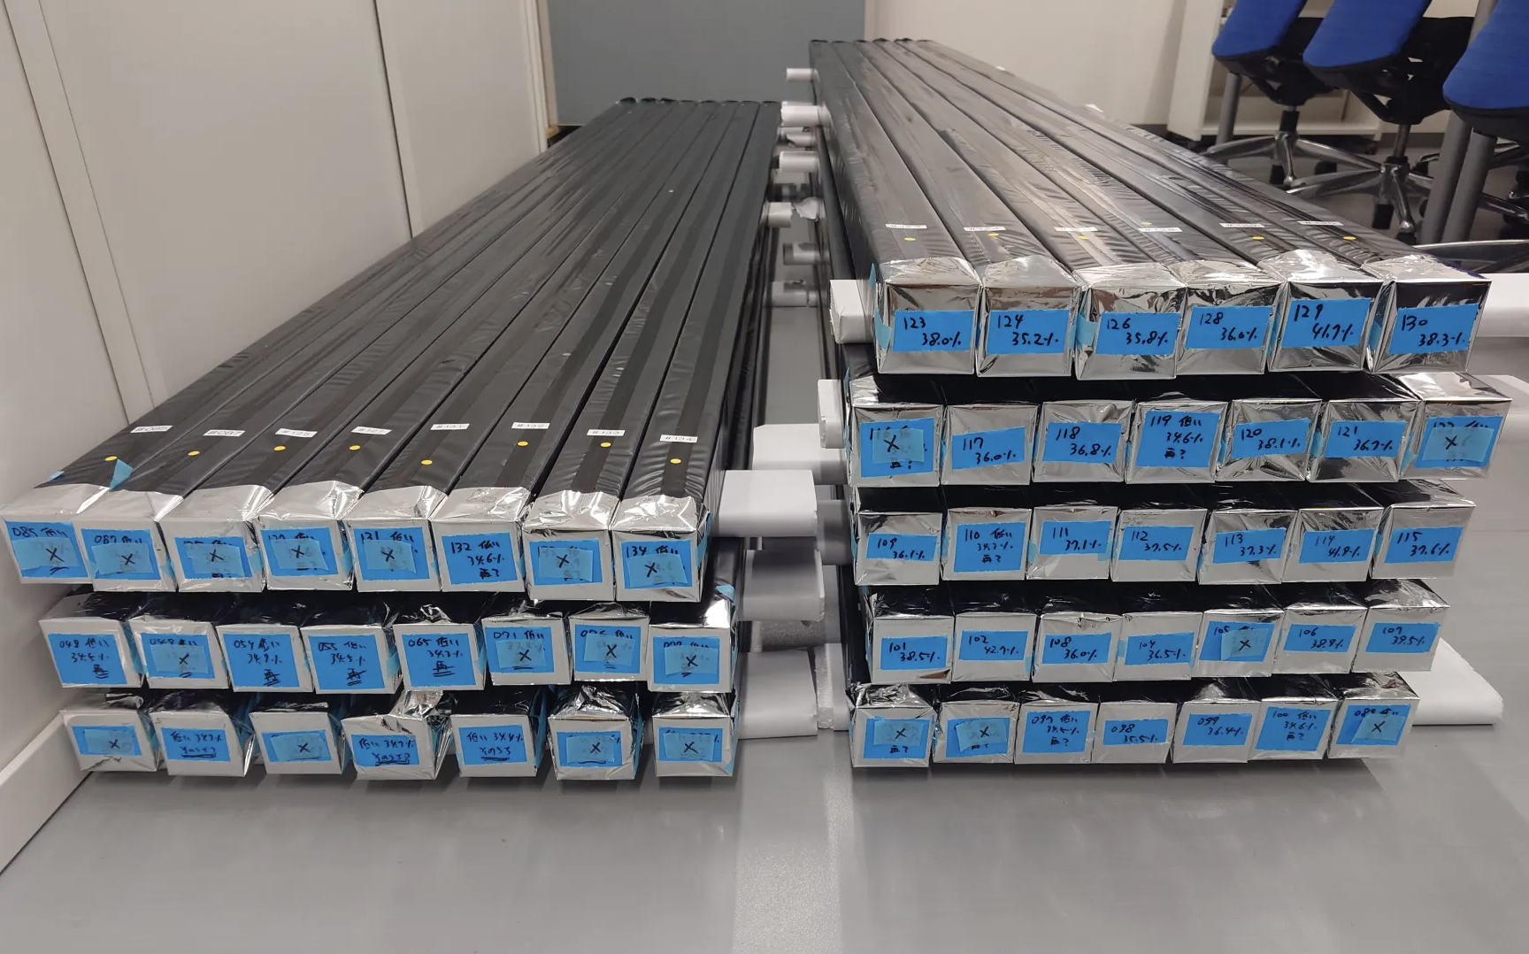
Status of the main components
Return York:
completed
SC Solenoid:
completed
CDC:
completed, in commissioning
CNC:
development with prototypes, to be completed this year

Slide 14
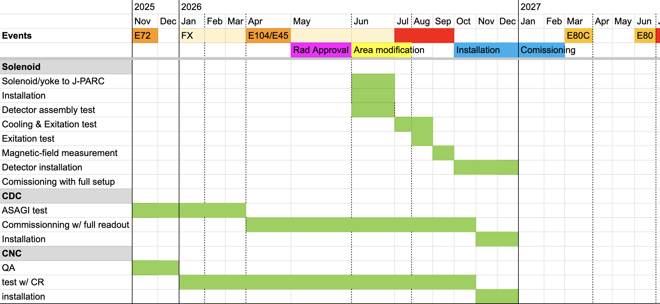
Plan for the main components

Slide 15
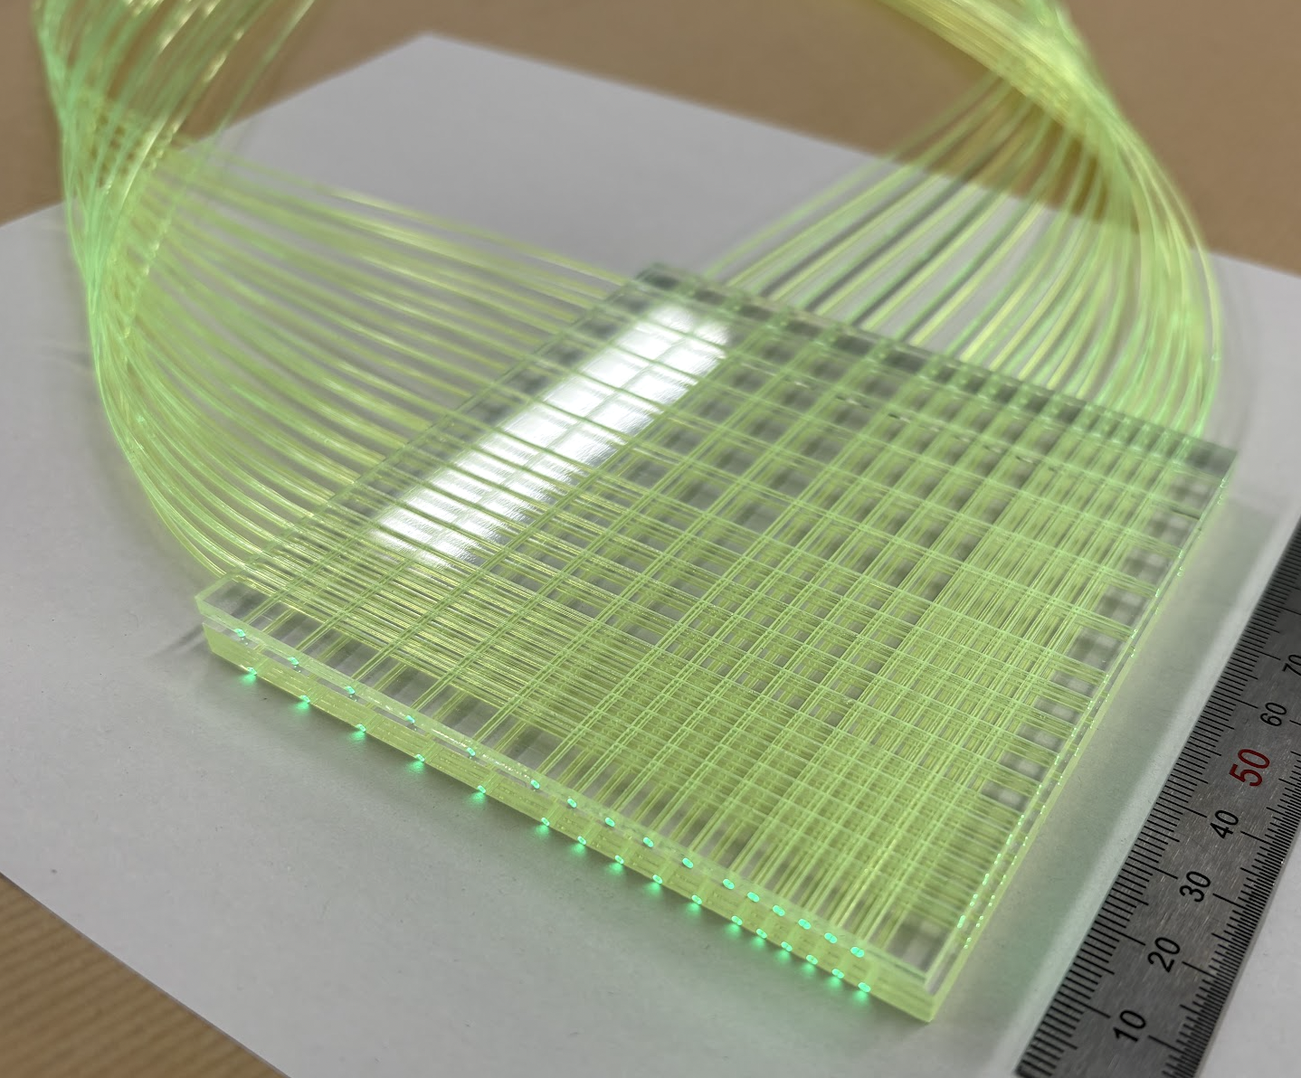
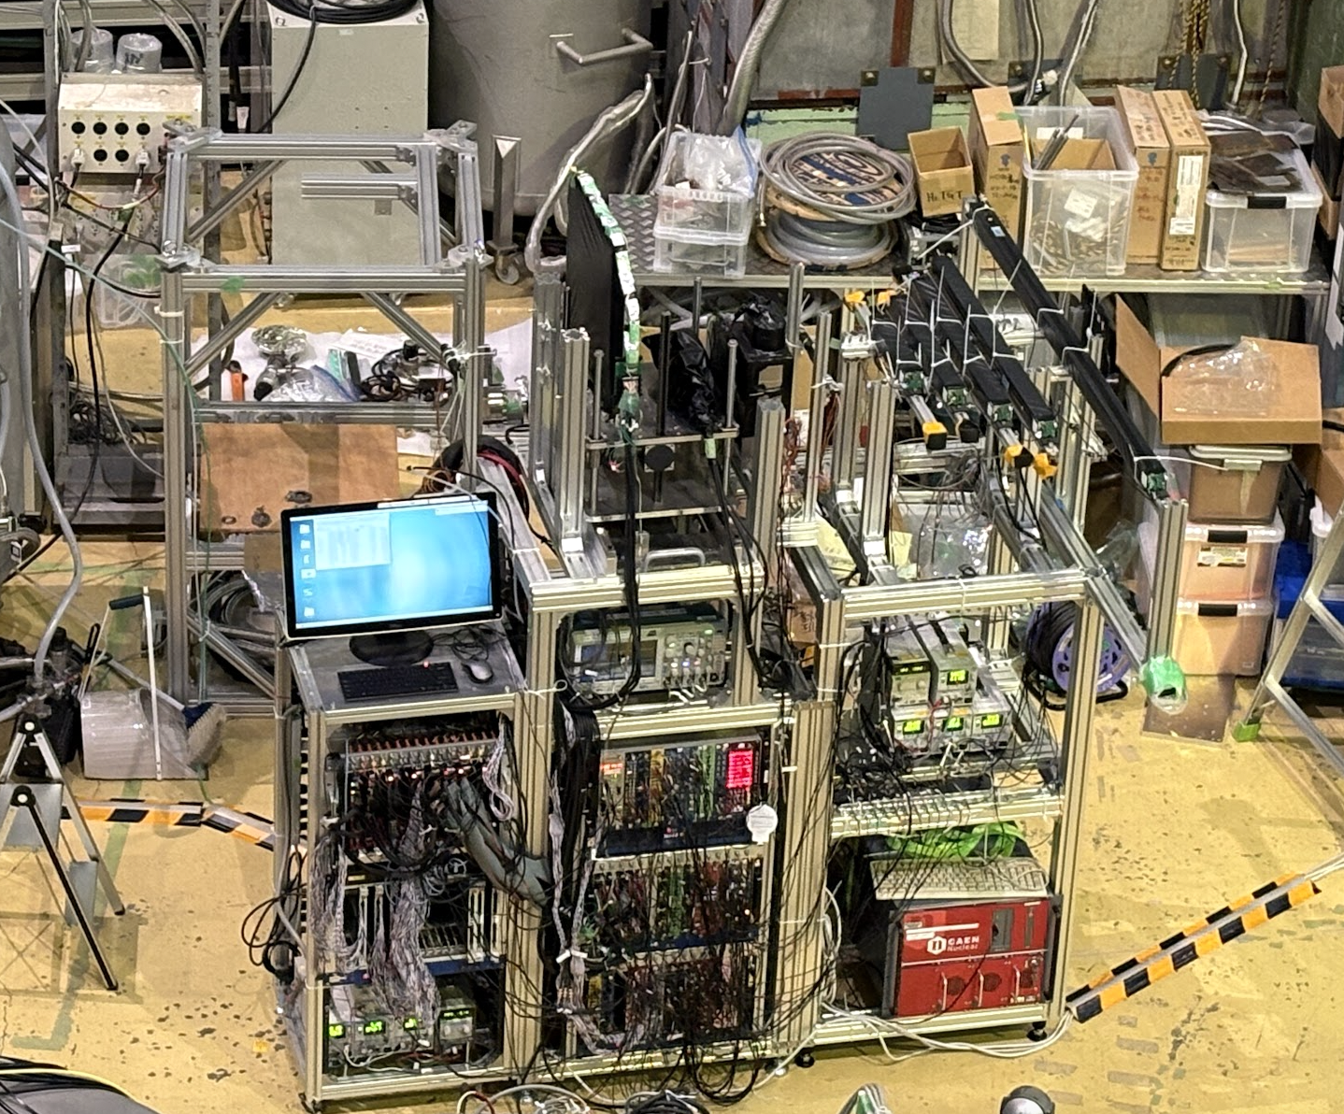
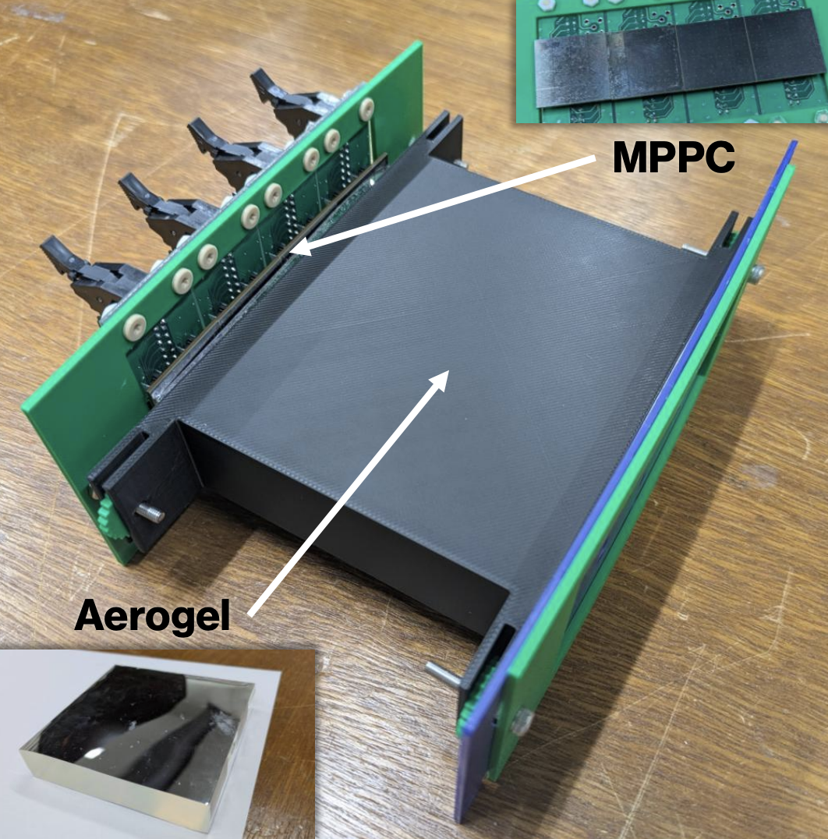
Status of the other new detectors
Polarimeter Tracker
@J-PARC K1.8BR
J-PARC E72 Parasite exp.
for R&D is ongoing. Y. Tsutsumi (U Tokyo, M1) for AC S. Ohtaka (RARiS, M1) for pol. tracker
CapTOF
Aerogel Čerenkov Counter
The other beam line detectors, VFT and the target system will basically be reused, with only minor modifications.

Slide 16
Summary and Prospect
We are preparing a new experiment on kaonic nuclei at J-PARC.
The construction of a large–solid-angle Cylindrical Detector System (CDS) is in progress.
Installation to the beamline is planned for next autumn, and the first physics data-taking for the J-PARC E80 experiment is expected by the end of FY2026.
A new era of kaonic-nuclei experiments is just ahead!
Thank you for your attention.

Slide 17

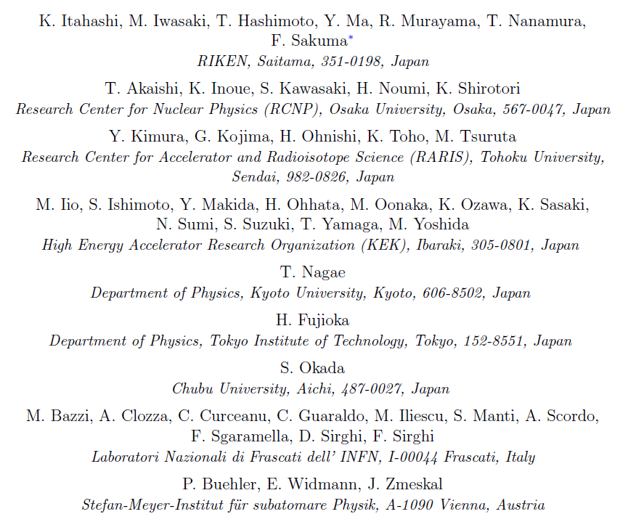








J-PARC E80 Collaboration

Slide 18
Back up

Slide 19
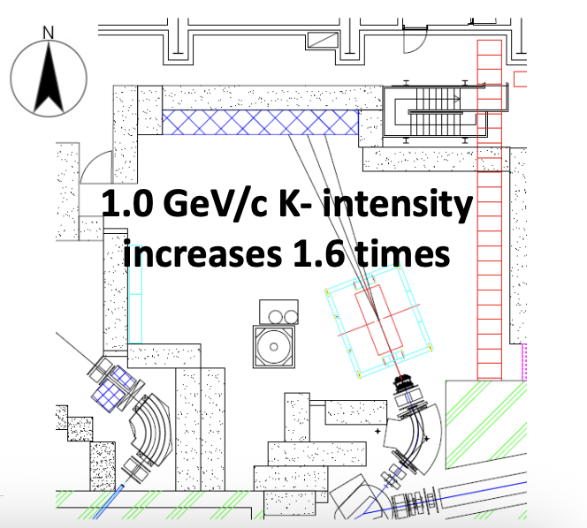

Slide 20
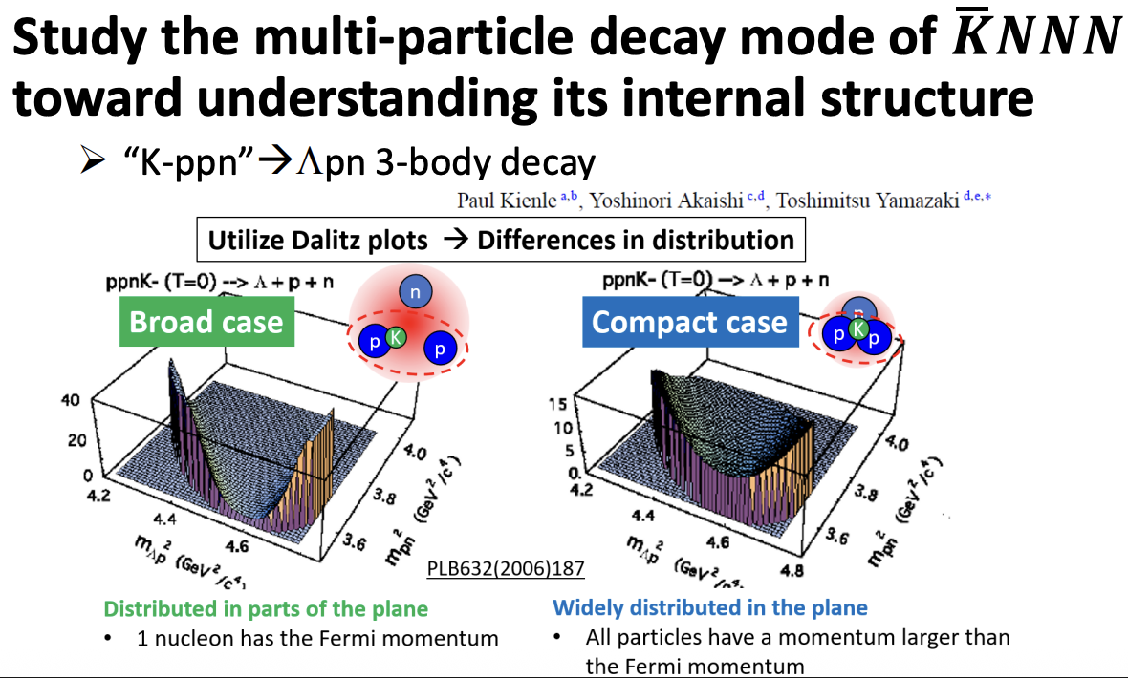

Slide 21
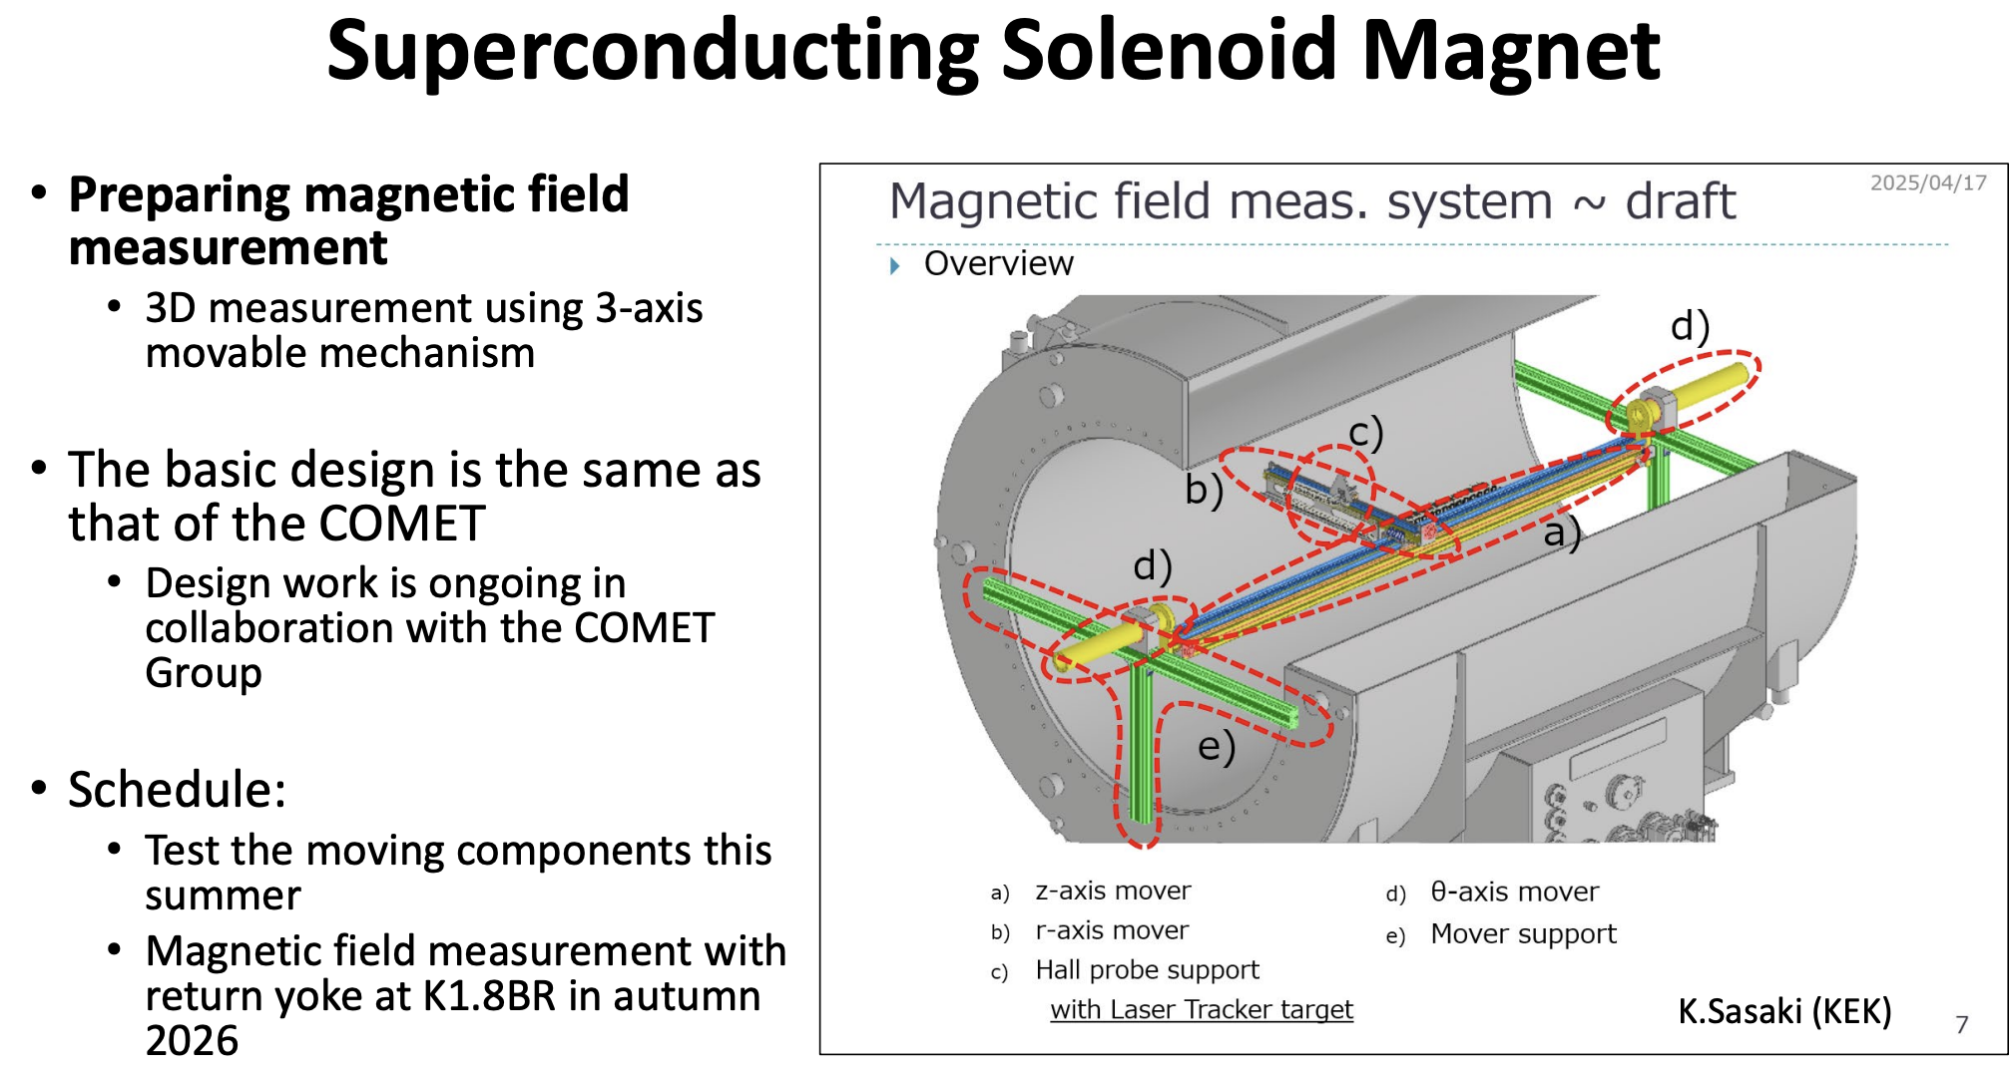

Slide 22
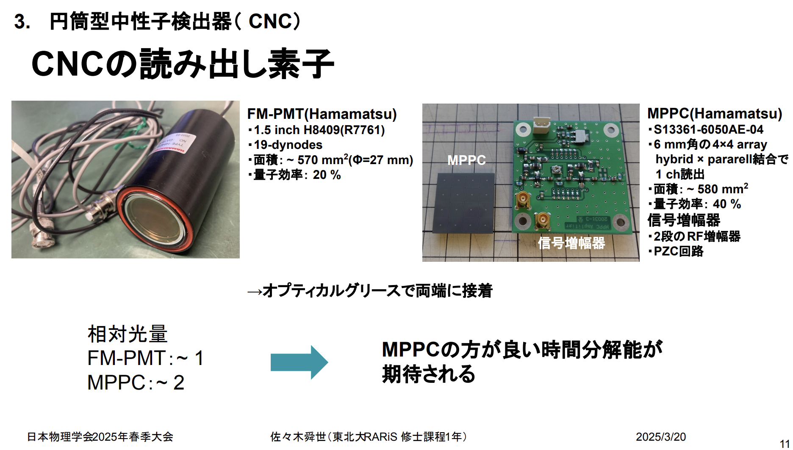

Slide 23
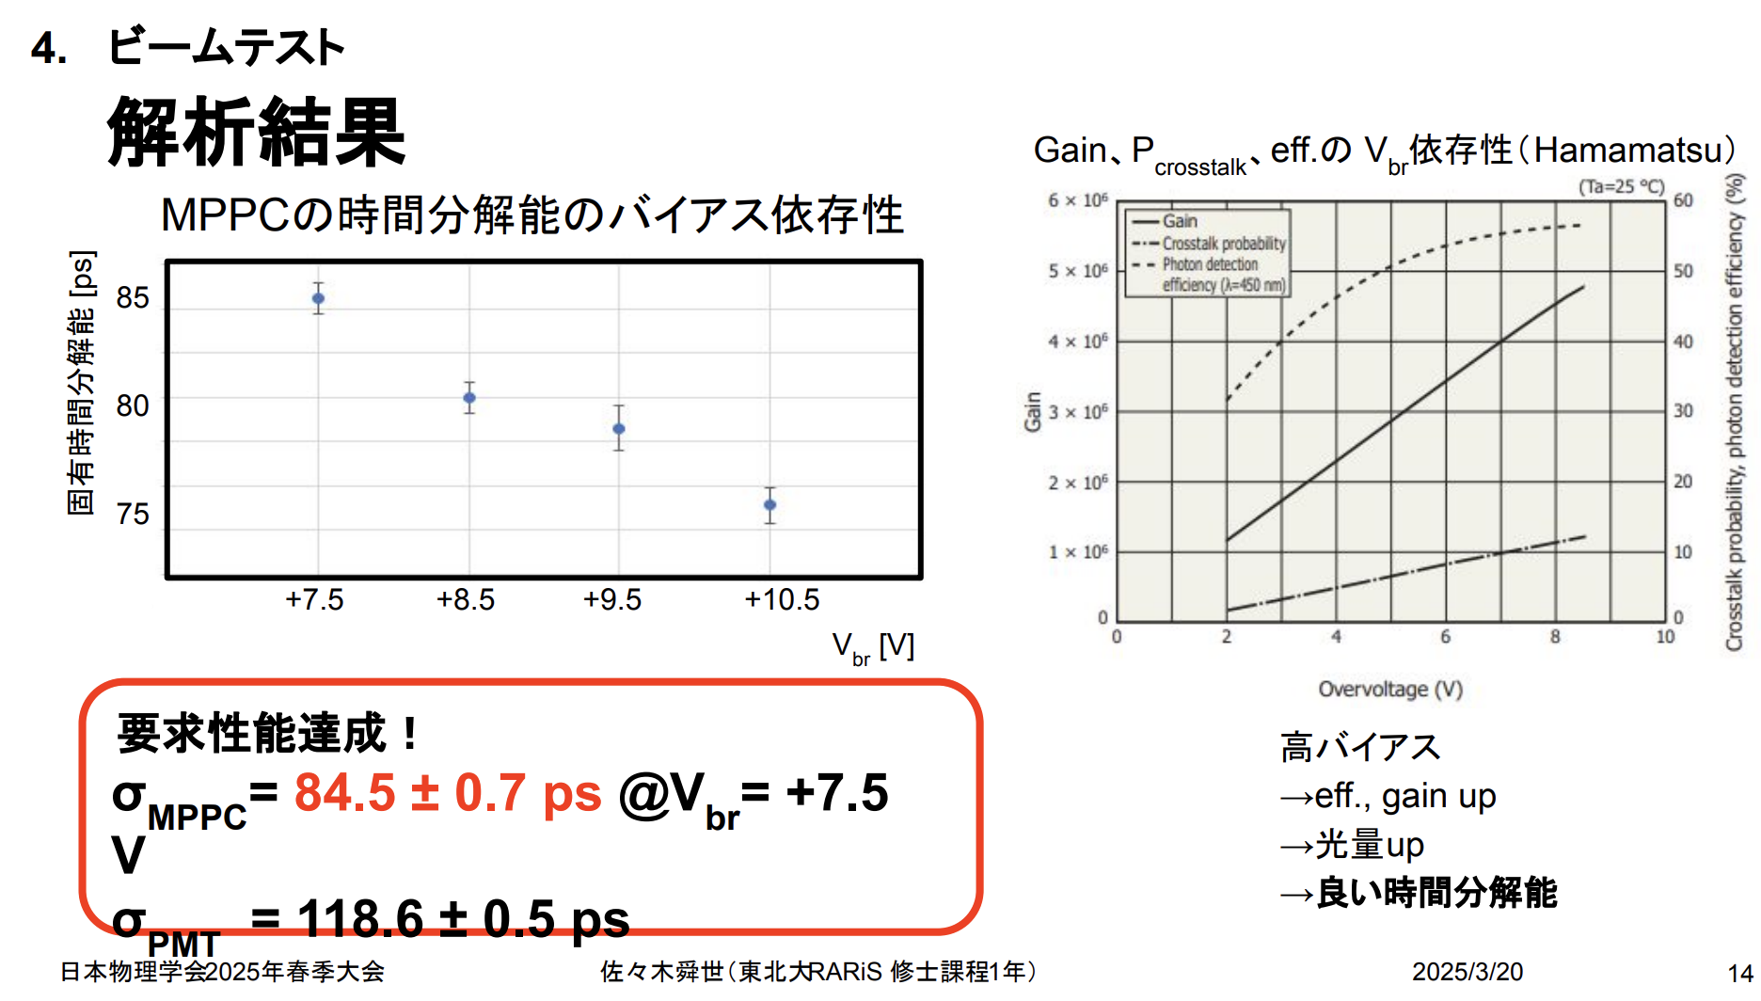

Slide 24
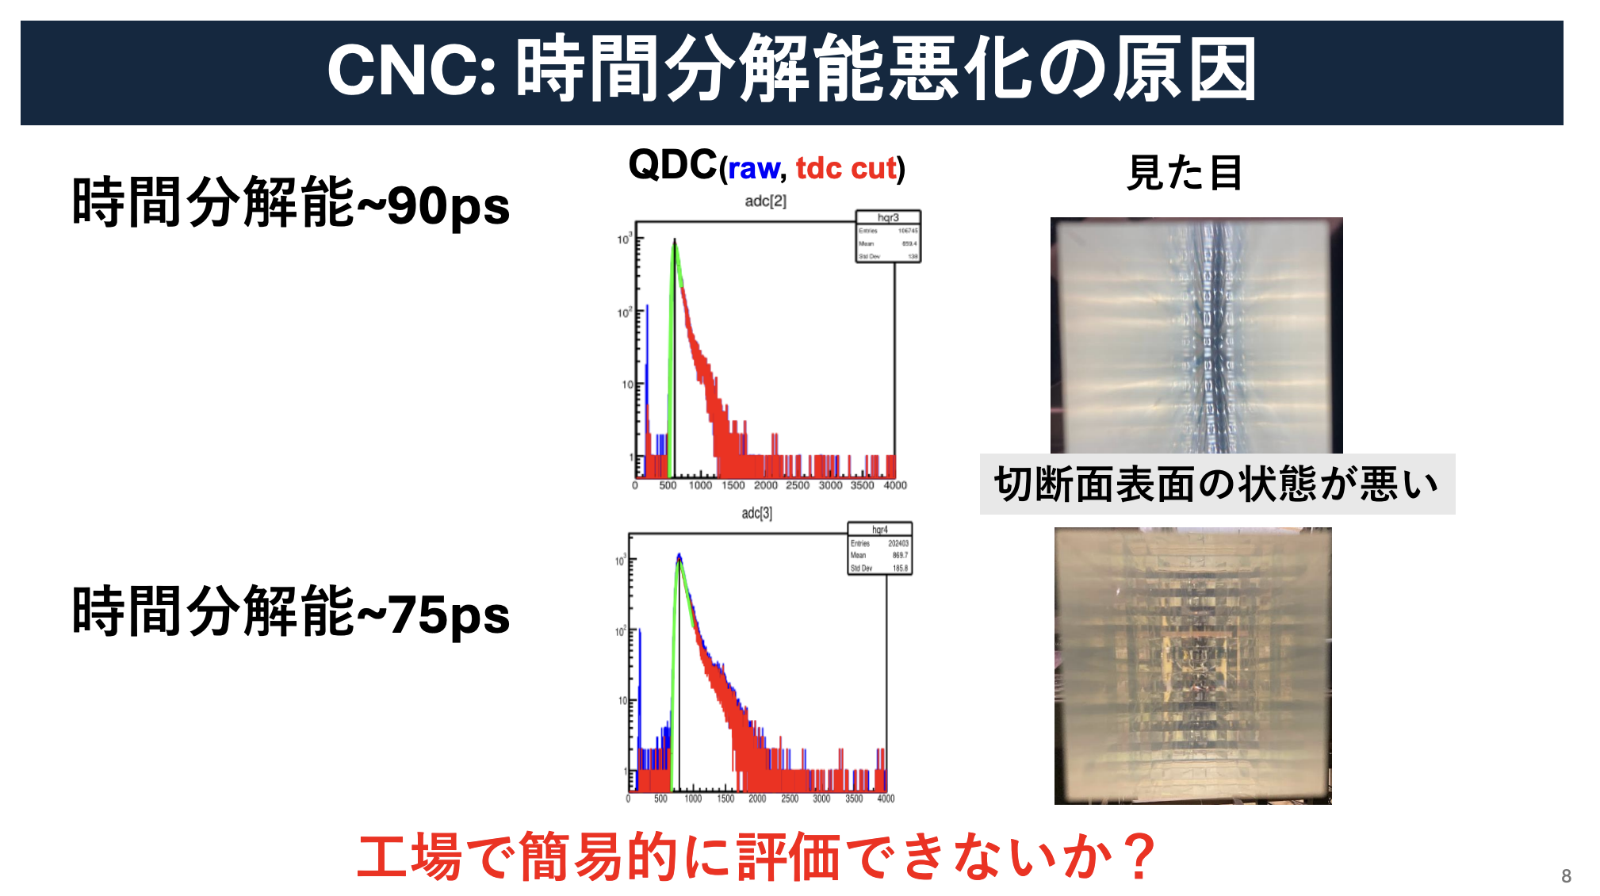

Slide 25
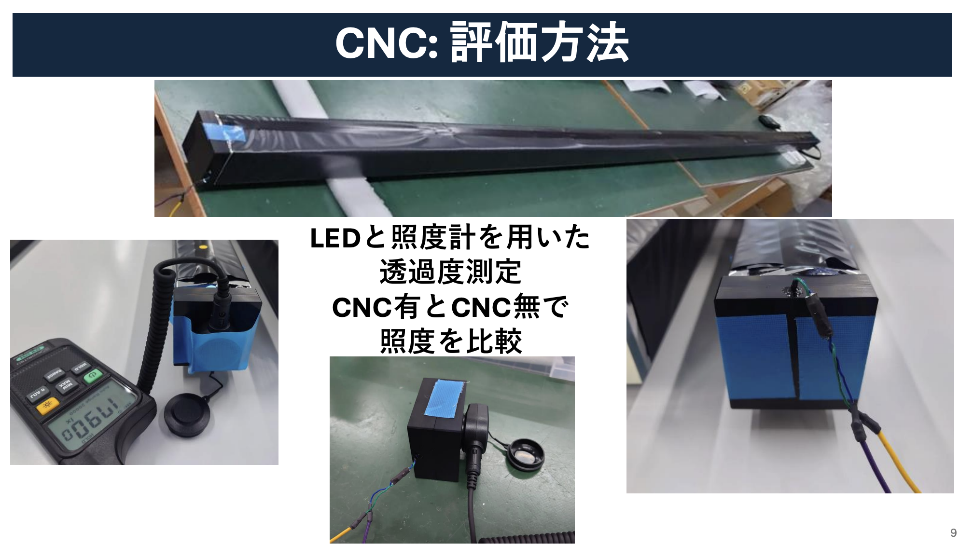

Slide 26
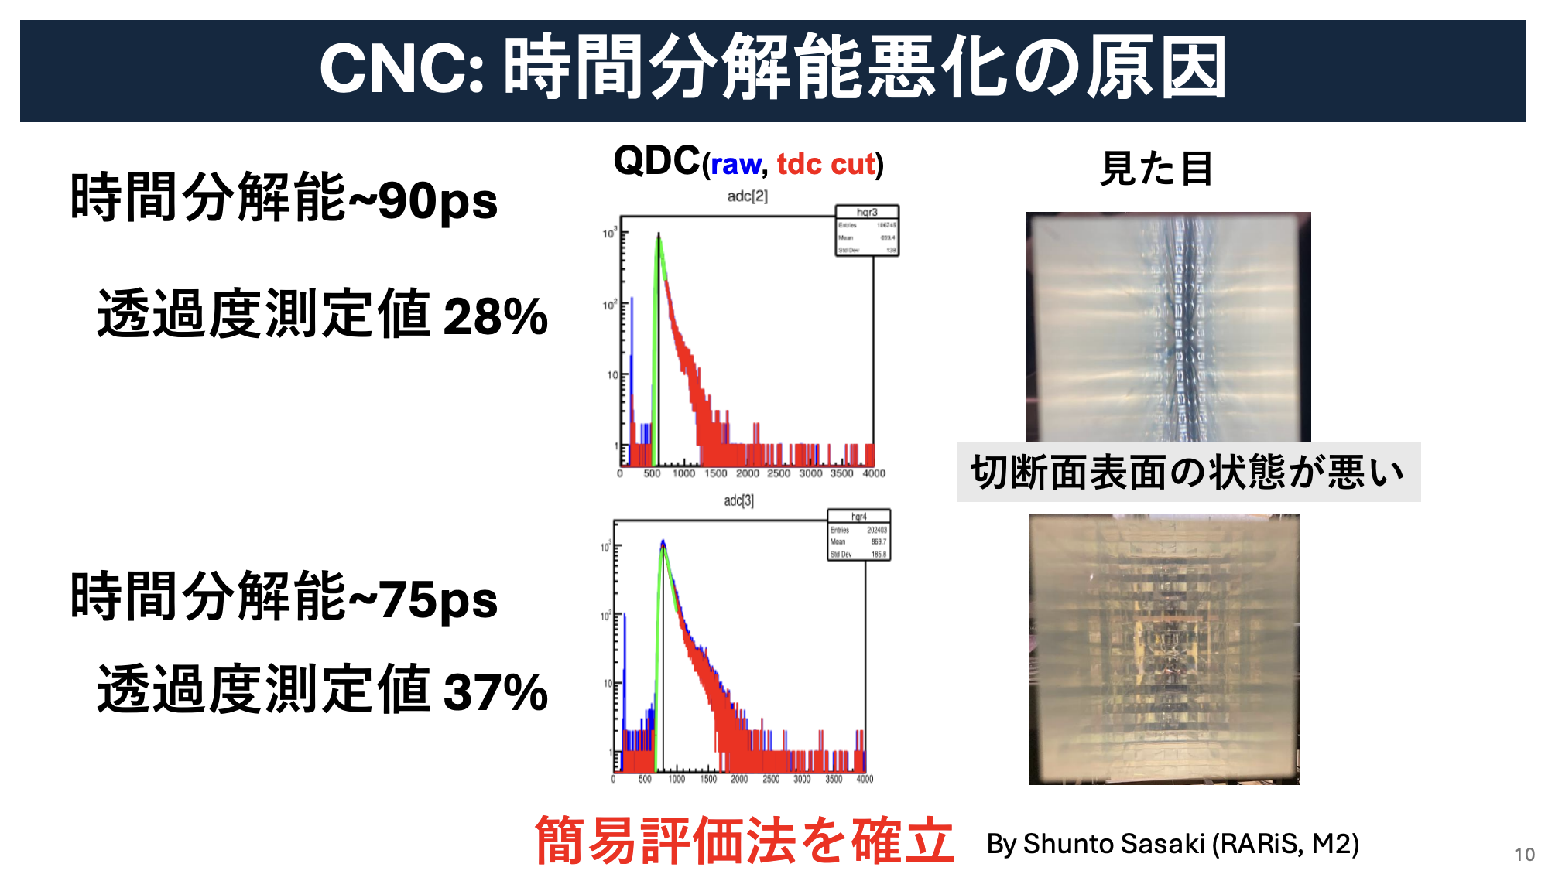

Slide 27
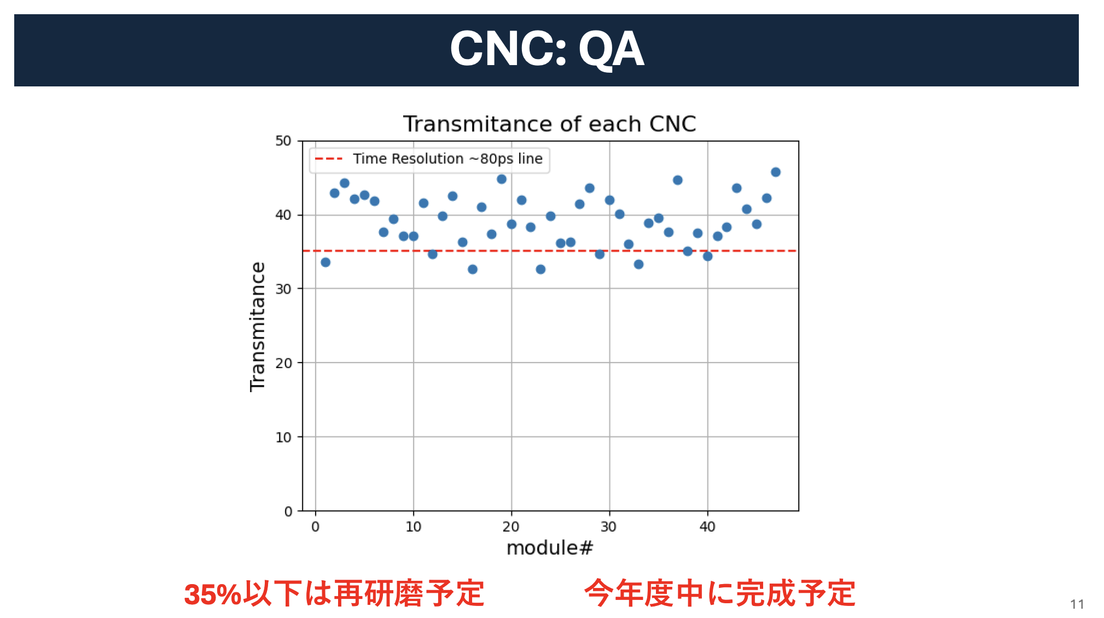

Slide 28
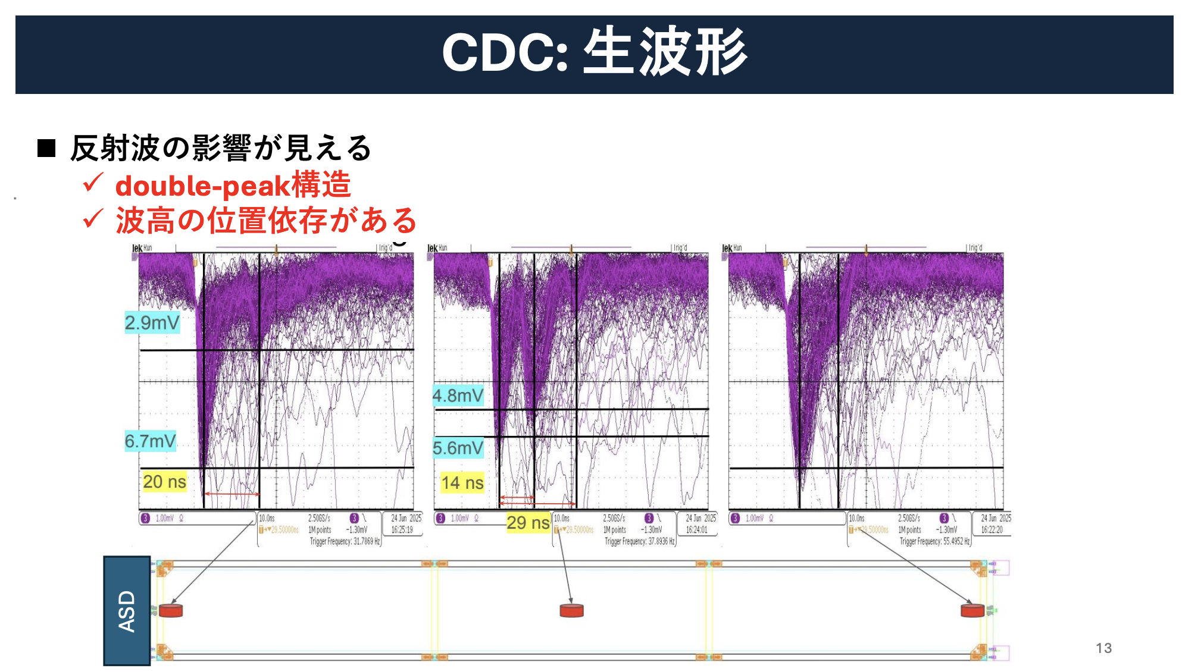

Slide 29
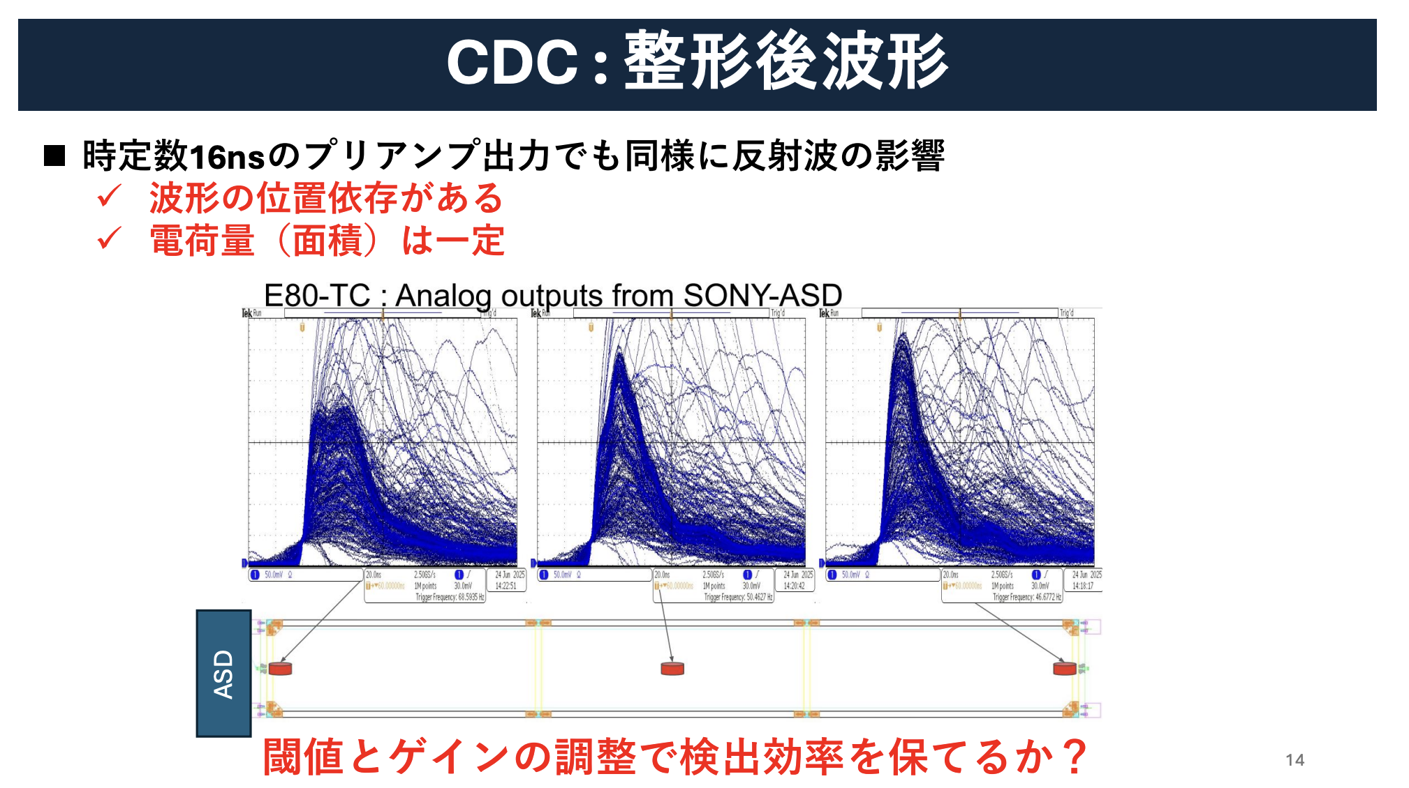

Slide 30
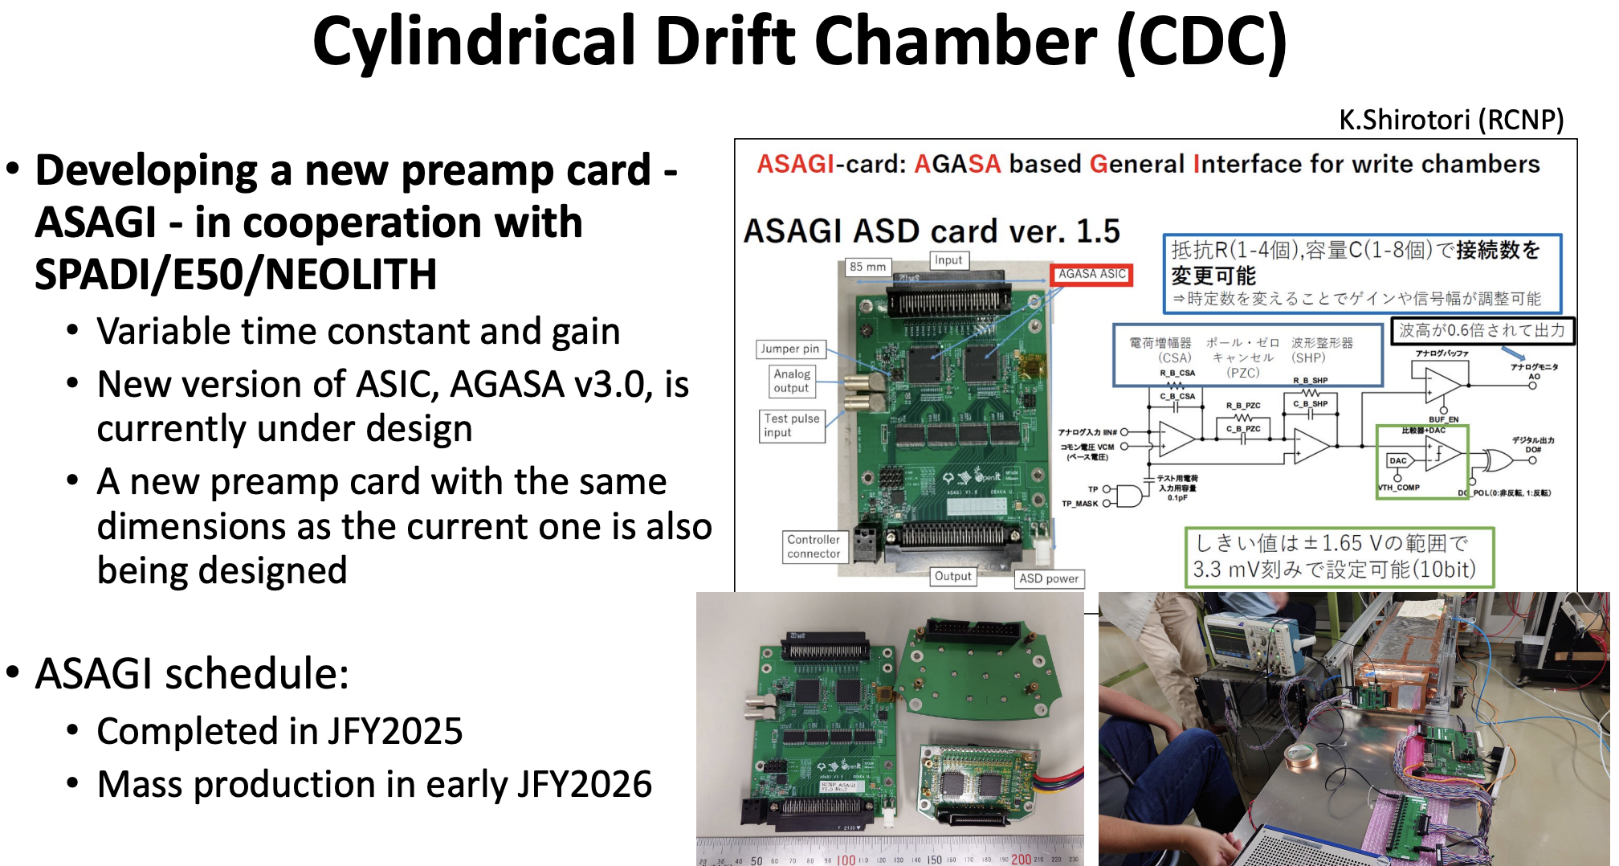

Slide 31


Slide 32


Slide 33


Slide 34


Slide 41




J-PARC E80: “$K^{−}ppn$”
AY: PRC65(2002)044005, PLB535(2002)70.
WG: PRC79(2009)014001.
BGL: PLB712(2012)132.
OHHMH: PRC95(2017)065202.
Kanada: EPJA57(2021)185.
Motivation:
Confirmation of “$K^{−}ppn$” (It should exist.) as a first step of the systematic investigation
B.E.
The larger nuclei, the larger B.E.?
Γ
Theory indicates kaonic nuclei beyond “$K^{−}pp$”.
(without multi-N absorption)
Systematic measurement will provide more conclusive evidence toward the general (heavier) kaonic nuclei.

Slide 42
J-PARC E80: “$K^{−}ppn$”
Spatial size from three body decay
Compact case
p
p
Λ
<
p
p
Λ
Λ
K–
p
Λ
n
n
p
n
n
n
Broad case
p
p
p
p
p
Λ
>
K–
Λ
Λ
p
Λ
n
n
n
n
n
K-nucl
Two nucleus absorption
Scenario 2
Scenario 1

Slide 43

J-PARC E89: Further study of “$\overline{K}NN$”
1. Confirmation of “$\overline{K^{0}}nn$”, iso-spin partner of “$K^{−}pp$”
p
K–
K–
n
p
p_{f}
p
n
1.0 GeV/c
Λ
n
Σ⁻
p
others
Measured by CDS
Neutron should be detected.

Slide 44


J-PARC E89: Further study of “$\overline{K}NN$”
2. Determine the spin-parity of “$\overline{K}NN$”
spin-spin correlation between Λ and p
We will use
the Λ -> pi- + p week decay asymmetry
proton scattering asymmetry
Proton is to be scattered by CNC.
Tracker for $p$-$C$ scattering is necessary.

Slide 45

J-PARC E89: Further study of “$\overline{K}NN$”
2. Determine the spin-parity of “$\overline{K}NN$”
There are two possible configurations for the $\overline{K}NN$ ground state.
Polarimeter for pC scattering is necessary.

Slide 46




Construction Status (Main Detectors)
Now
Beamline Upgrade
 | FY2022 |  |  |  | FY2023 |  |  |  | FY2024 |  |  |  | FY2025 |  |  |  | FY2026
Yoke | Construction |  |  |  |  |  |  |  |  |  |  |  |  |  |  |  |  |  | Install ↓ Phys. Run
SC Solenoid | Purchase |  |  |  | Construction |  |  |  |  |  |  | Excitation Test
CNC |  |  | First Prot-type Performance Test |  |  |  |  |  | Second Prot-type Performance Test |  |  |  |  | Purchase | QA | Further study of readout
CDC | Purchase |  |  | Construction |  |  |  |  |  | Commissioning
Yoke
SC Solenoid
CDC
CNC

